Slide 1
The rock cycle
Chapter 5

Slide 2
The Rock Cycle Chapter
The three rock groups
Rock terms
Plate margins
Quarrying
The rock cycle

Slide 3
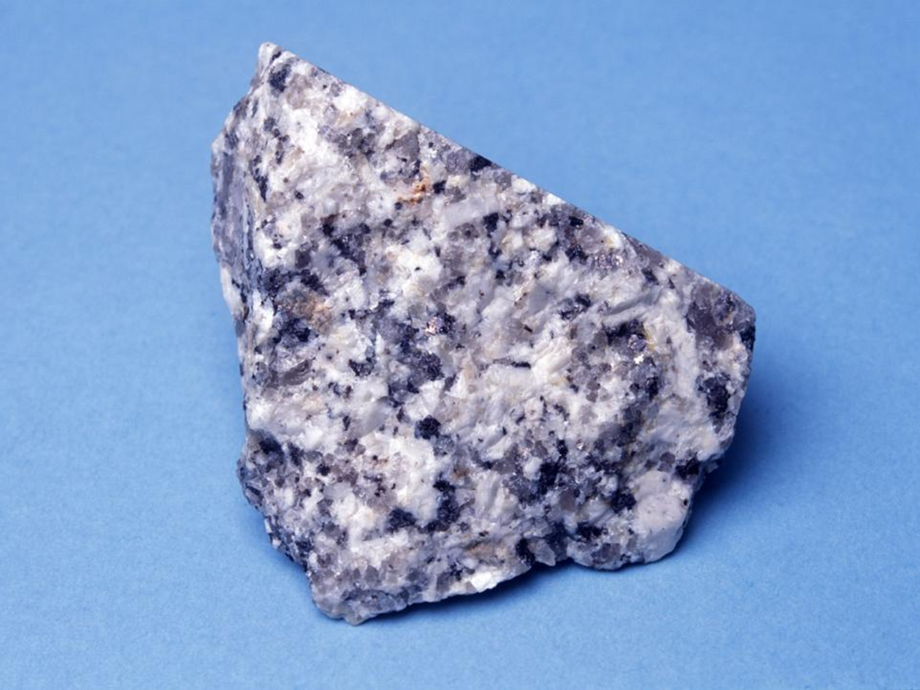
Igneous Rocks

Slide 4
How are igneous rocks formed? | Name two famous igneous rocks | Where are they found in Ireland? | What do we use igneous rocks for?
Igneous rocks are formed when hot molten magma (in the crust) cooled down and solidified (or as lava on the land). In the earths crust they are called ‘intrusive’ and on the surface they are called ‘extrusive’. | Intrusive rocks in this group include Granite and extrusive rocks include Basalt. | Basalt is found in the Giants Causeway in Co. Antrim. Grey/Black in colour and contains small crystals. Granite is found in the Wicklow Mtns, varies in colour and has large crystals due to cooling slowly. | Basalt is used in tarmac for road surfacing and granite is used for kitchen worktops or fireplaces.

Slide 5
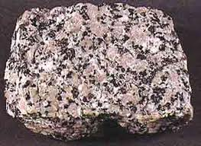
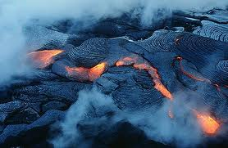
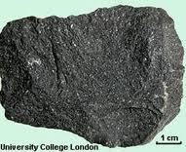
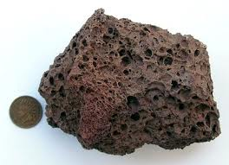

Slide 6
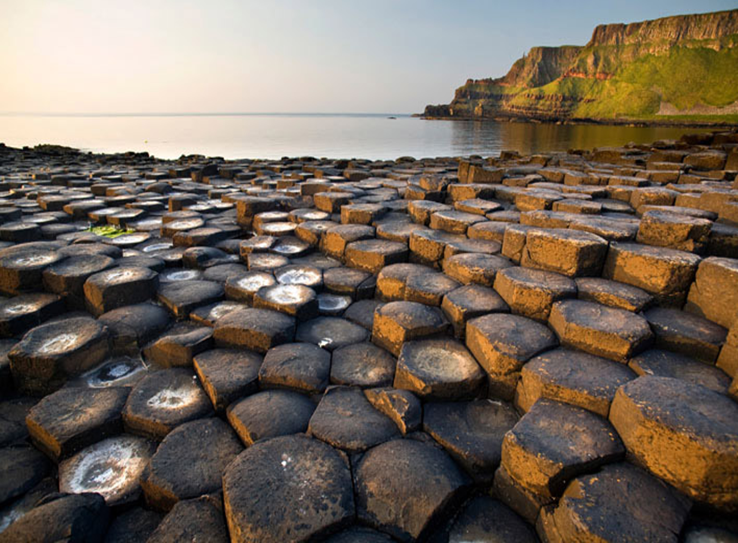
Giants Causeway,Co.Antrim
Basalt

Slide 7
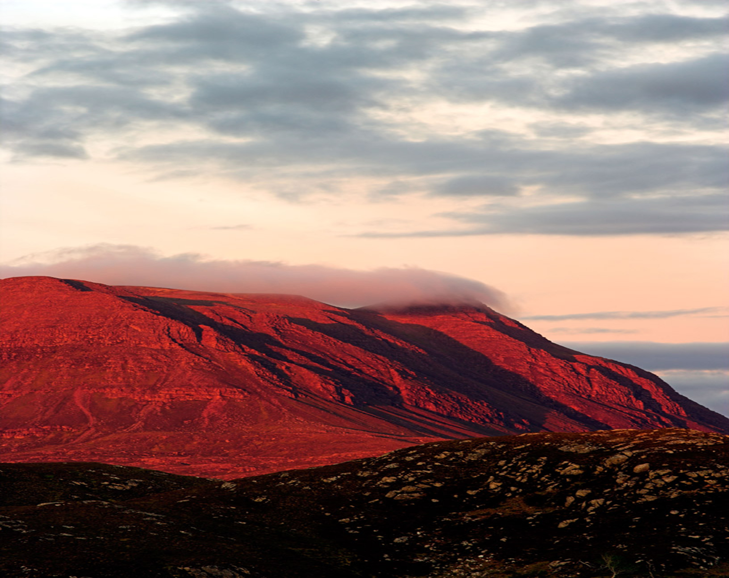
Sedimentary Rocks

Slide 8
How are sedimentary rocks formed? | Name two famous sedimentary rocks | Where are they found in Ireland? | What do we use sedimentary rocks for?
Sedimentary rocks are formed due to the compression of the remains of plants, animals or other rocks. | Limestone can be white/grey or black. Limestone is an organic rock (made from the remains of living things). Sandstone (brown or red) inorganic rock as it is made from the remains of other rocks. | Limestone is found in the central plains of Ireland and the Burren in Co. Clare. Sandstone is found in the Comeragh mountains of Co. Waterford and Cork. | Limestone is used for the façade of buildings. Sandstone is used in the mixture of cement and building blocks.

Slide 9
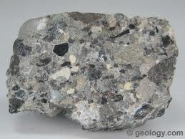
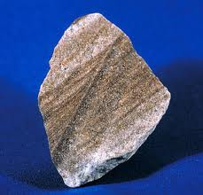
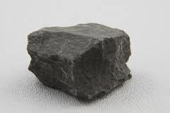
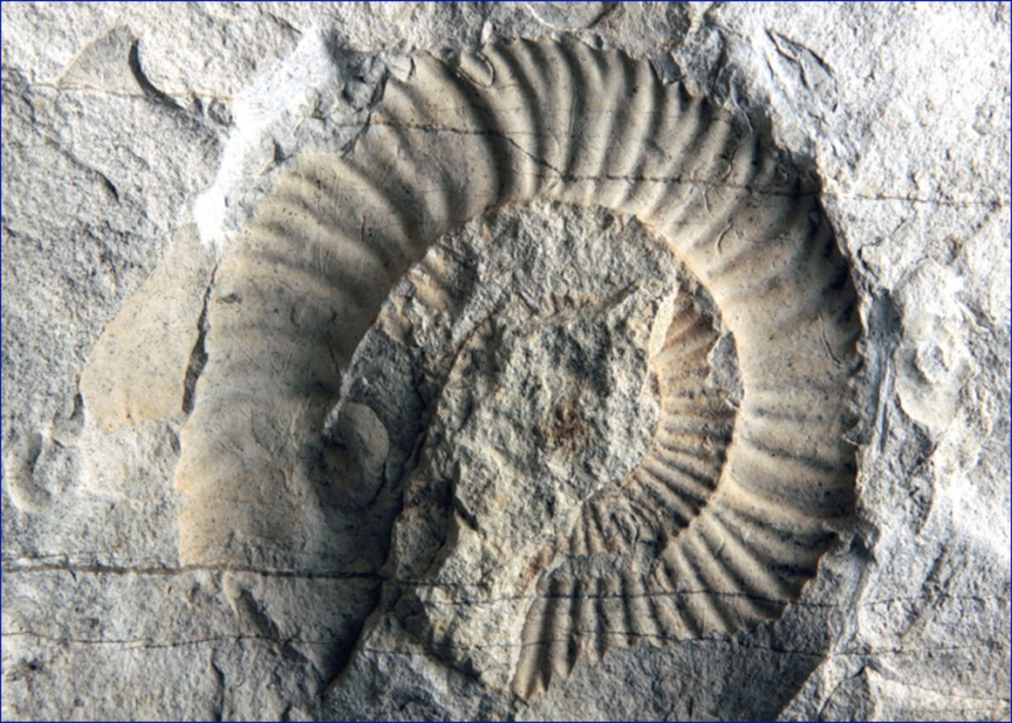
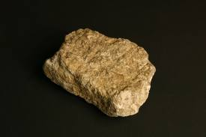

Slide 10
Metamorphic Rocks

Slide 11
How are metamorphic rocks formed? | Name two famous metamorphic rocks | Where are they found in Ireland? | What do we use metamorphic rocks for?
Metamorphic rocks are formed when igneous or sedimentary rocks are changed by great heat or pressure. | Marble is a white/pink rock that was Limestone before changed by great heat. Slate was shale before being changed due to tectonic pressure. | Marble is found in Connemara in Galway, Kilkenny and Achill Island. Quartzite is found in Mt. Errigal in Co. Donegal. | Marble is used for household tiles, fireplaces and headstones. Quartz is used in costume jewellery, quartzite is used in road chippings and Slate is used as a roofing tile.

Slide 12
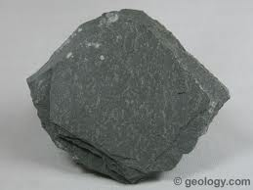
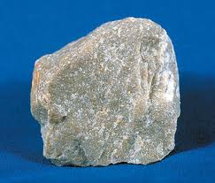
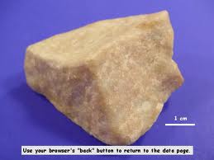
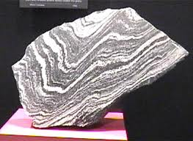

Slide 13
The Rock Cycle

Slide 14
The rock cycle
Rocks continually form, change, are destroyed and reform
Endogenic forces – (actions in the crust) = construct and change rocks
Exogenic forces – (actions like weathering on the surface) =Destroy rocks

Slide 15
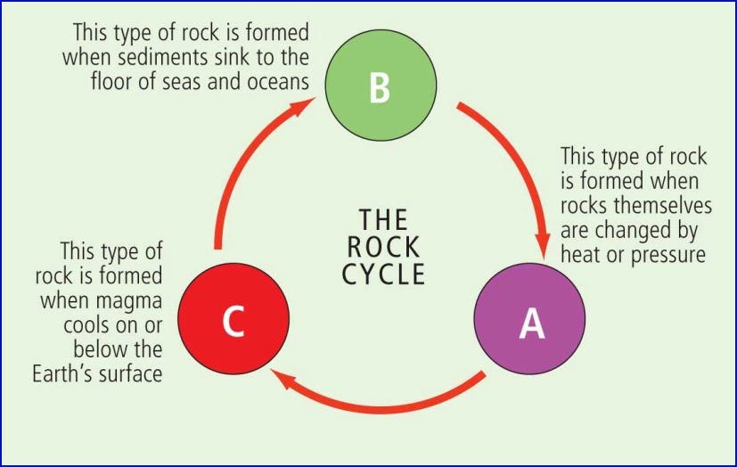
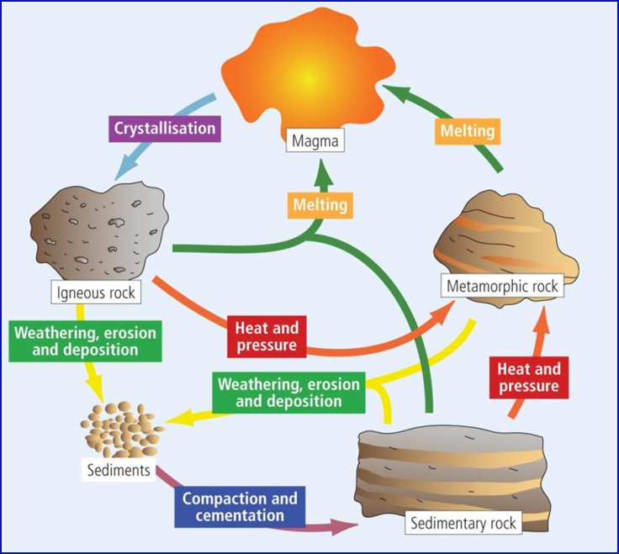

Slide 16
Terms to know

Slide 17
Plutonic rocks
Formed within the Earth
Intrusive
e.g. granite
Volcanic rocks
Formed at the surface of the Earth
Extrusive
e.g. basalt

Slide 18
Quarrying

Slide 19
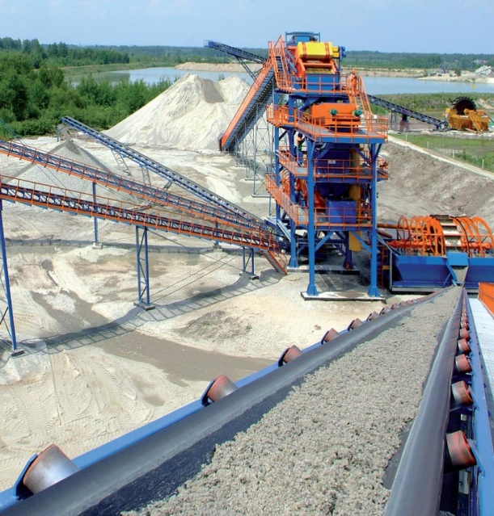
Chapter 5: The Rock Cycle
1. Methods of quarrying
I. Plug and feather
drilling holes
split the rock
extracting large pieces, e.g. floor covering
II. Explosive
extracting large and small pieces of rock
III. Channeling
machinery cuts large slices of rock
metamorphic rock such as marble

Slide 20
Chapter 5: The Rock Cycle
2. Positive impacts of quarrying
Direct employment
Construction
Indirect employment

Slide 21
Chapter 5: The Rock Cycle
3. Negative impacts of quarrying
Visual pollution
Noise pollution
Heavy machinery damage to infrastructure
Dust pollution
Water pollution
Disused quarries

Slide 22
Plate Margins

Slide 23
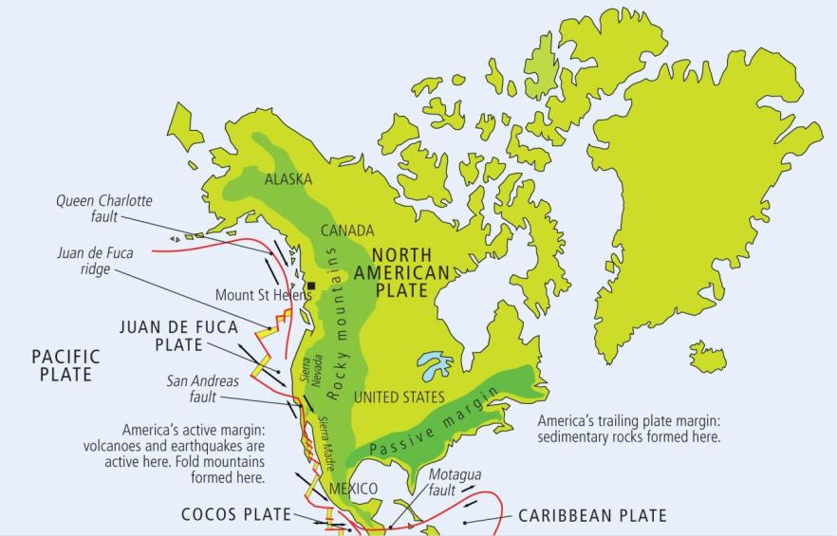
Active plate margins
Oceanic plate subducting under a continental plate
e.g. west coast of North America Pacific plate subducting under North American plate

Slide 24
Trailing plate margin
Absence of earthquake, volcanic activity or folding
Sedimentary rocks form, e.g. sandstone and limestone

Slide 25
Summary Time
Name the three rock groups
Explain how rocks in each group formed
Give two examples of rocks in each group
Say where you would find each type of rock in Ireland
How are different rock used in daily life
What is the rock cycle and how/why rocks are changed
Explain each of the following words:
Geotectonic
Plutonic
Exogenic
Endogenic
Volcanic
Give three positive and three negative effects of quarrying
What are active plate margins and trailing plate margins?

Slide 26
Match the terms/descriptions
When magma cooled down on or in the earths crust
Was changed by great heat into marble.
The formation and structure of rocks on the earths surface.
Rocks formed from the broken down remains of other rocks.
An inorganic rock usually brown or red in colour due to amount of iron oxide.
When sediments are compacted together under pressure and over time turn into rock.
A hole is drilled, split and large pieces of rock are extracted.
Where there is an absence of earthquake/volcanoes/fold mountain activity.
Heavy machinery can damage the roads.
When magma cools and hardens in the crust this type of rock is formed.
A fine to medium-grained rock which ranges in colour.
A rock high in calcium carbonate.
Named after the city Carrara in Italy.
People who work in Irelands pits and quarries.

