Slide 1
11 Rivers: Fluvial Processes, Patterns and
Associated Landforms, and
Human Interaction
River (Fluvial) processes, patterns and associated landforms
Human activities, interaction and impact on the operation of surface processes, such as hydroelectric dams, canalisation and flood control measures = How humans use/abuse rivers

Slide 2
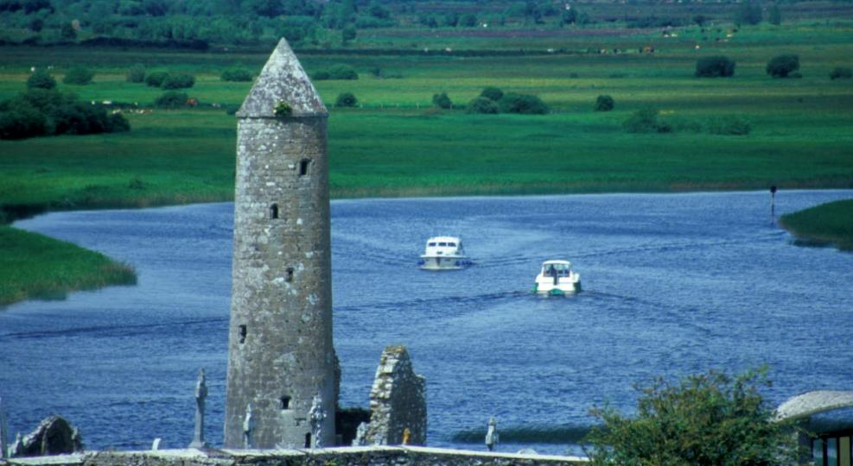
Chapter 11: Fluvial Processes, Patterns and Landforms, & Human Interaction
Rivers
Change the landscape in three main ways:
Erosion – wearing away of the land by river
Transportation – moving its load downstream
Deposition – dropping its load

Slide 3
In this chapter we will:
Learn the main river terms you need to know
Learn the three stages of a river
Learn the five main processes of erosion
Learn the five ways a river moves its load
Learn how each stage has a different slope and features
Look at how we write out full descriptions on some of these features
Examine how humans use and abuse rivers around the world.

Slide 4
River terms

Slide 5
Chapter 11: Fluvial Processes, Patterns and Landforms, & Human Interaction
Important terms
Load – a river transports eroded ______________
Source – where a river _____________
Course – the _________ a river takes as it flows from an upland area down through its valley until it enters the sea
Tributary – a stream/river which ________ a larger river
Mouth – the place where a river ________ the sea or lake

Slide 6
Chapter 11: Fluvial Processes, Patterns and Landforms, & Human Interaction
Chapter 11: Fluvial Processes, Patterns and Landforms, & Human Interaction
Important terms (continued)
Estuary – where a river mouth is __________
River basin – the _______ ______which is drained by a river and its tributaries
Watershed – the high ground that ____________ two river basins
River discharge – the __________ or ___________ of water carried by a river at a given time

Slide 7
How a river moves its load

Slide 8
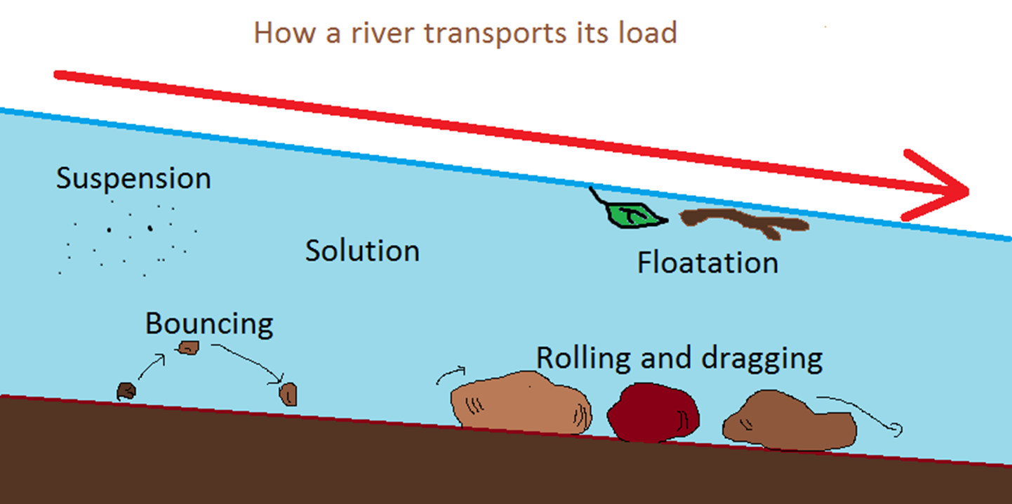
Chapter 11: Fluvial Processes, Patterns and Landforms, & Human Interaction
Processes of transportation
Rivers transport their load by four processes:
Solution
Suspension
Saltation
Traction
Floatation

Slide 9
A quick guide to rivers

Slide 10
Stage | Upper Course | Middle Course | Lower Course
Slope
Main processes
Valley shape
Main features

Slide 11
Stage | Upper Course | Middle Course | Lower Course
Slope
Main processes
Valley shape
Main features

Slide 12
The work of a river

Slide 13
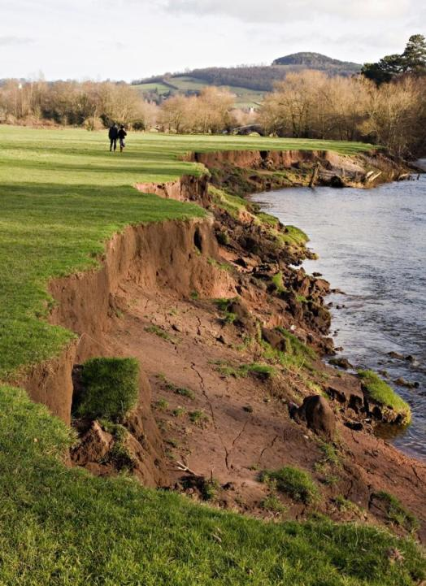
Chapter 11: Fluvial Processes, Patterns and Landforms, & Human Interaction
Rate of river erosion
Depends on the following:
Size
Speed
Hardness of the rock the river flows over

Slide 14
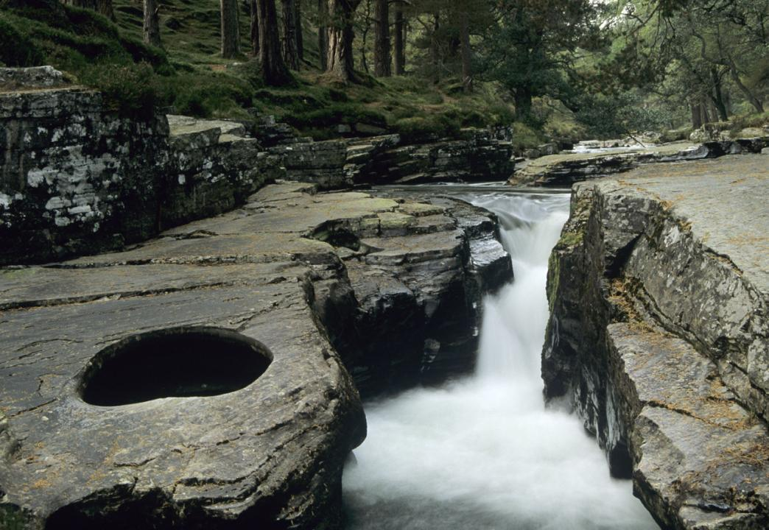
Chapter 11: Fluvial Processes, Patterns and Landforms, & Human Interaction
The velocity/speed of a river Influenced by:
Slope
Amount of water in the river
Roughness of the channel
Shape of river channel

Slide 15
5 processes of erosion

Slide 16
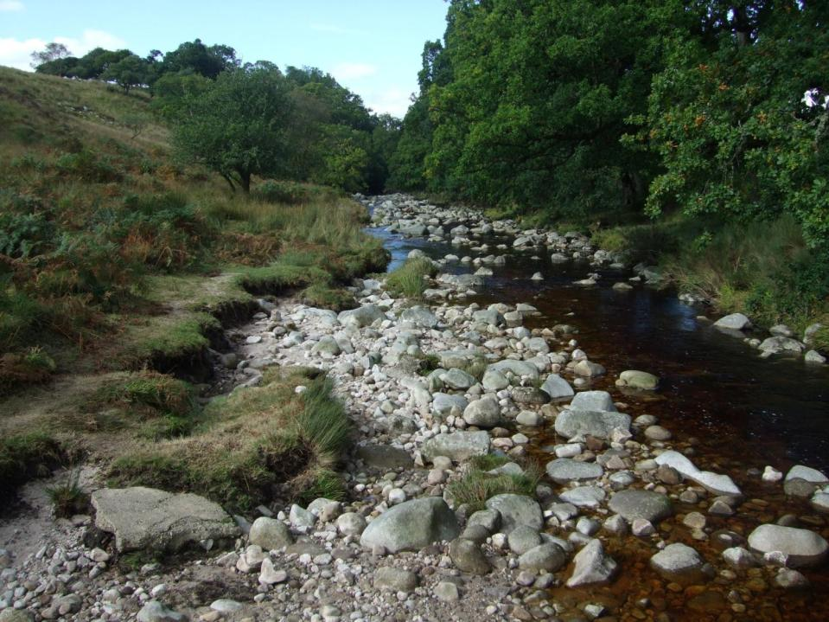
Chapter 11: Fluvial Processes, Patterns and Landforms, & Human Interaction
Processes of fluvial erosion
Rivers erode through a number of processes:
Hydraulic action
Abrasion
Chemical solution
Cavitation
Attrition

Slide 17
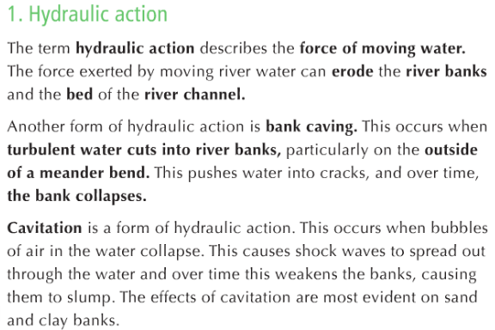
5 processes of erosion

Slide 19
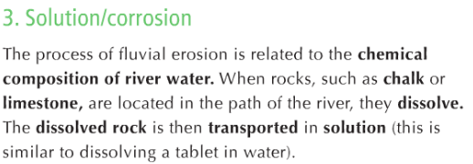

Slide 20
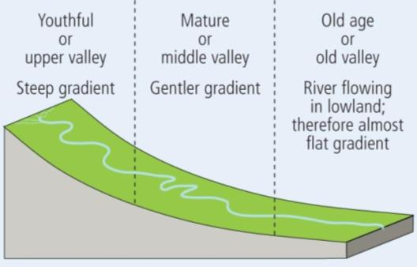
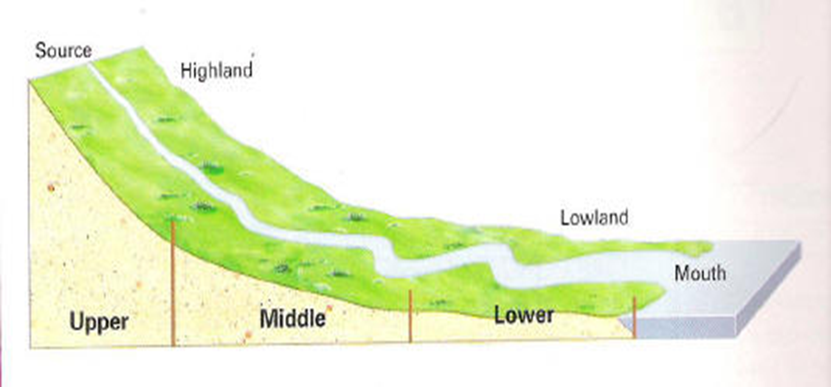
Chapter 11: Fluvial Processes, Patterns and Landforms, & Human Interaction
River profile
Three stages can be identified:
Youthful or upper river valley
Mature or middle river valley
Old age stage or old river valley

Slide 21
Describing a feature
F.E.E.D
F: Feature (Name, erosion or deposition, stage it is found)
E: Explain with at least one or two processes explained
E: Three examples, one Irish
D: Clear 1/2/3 diagram/s to show how the feature is formed.

Slide 22
Three features we will study
Youth Stage = Waterfalls
Mature Stage = Meanders and Oxbow Lakes
Old age Stage = Deltas
In detail

Slide 23
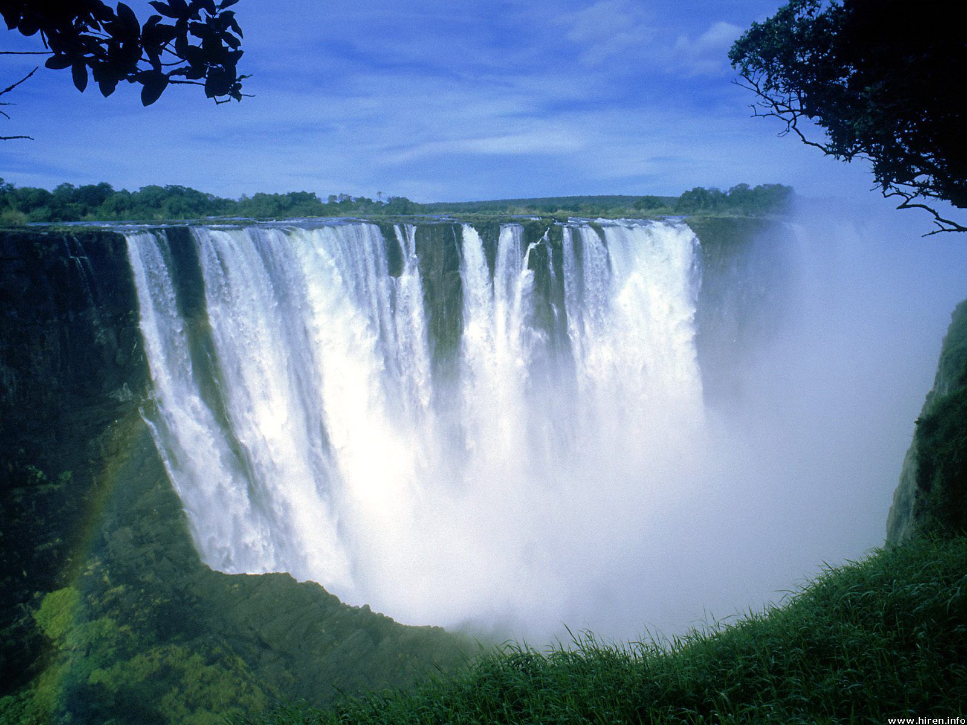
Waterfalls

Slide 24
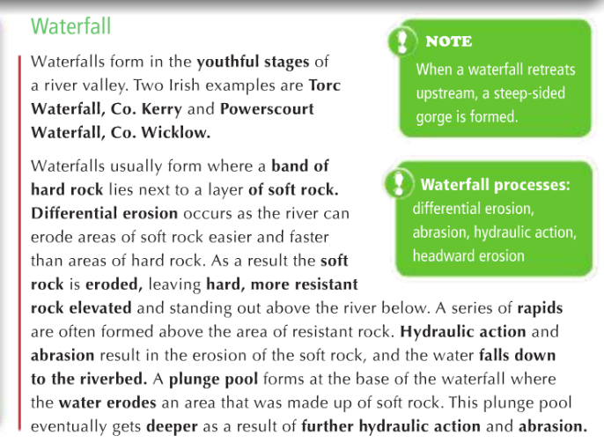
Circle the key details we can use
Page 104

Slide 25
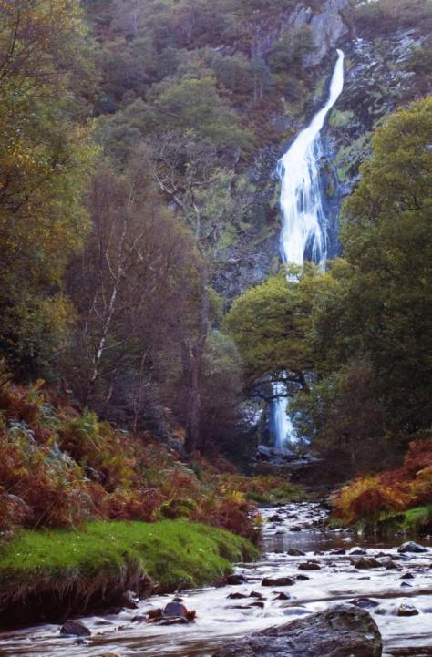
Chapter 11: Fluvial Processes, Patterns and Landforms, & Human Interaction
Features of youthful river
II. Waterfall
Formed in the youthful stage of a river valley
Created where a band of hard rock lies next to a layer of soft rock
Differential erosion occurs
Soft rock is eroded quicker.
Leaves hard, more resistant rock
As the process continues the drop over the more resistant rock becomes steeper
River flows over the resistant rock forms a waterfall

Slide 26
Chapter 11: Fluvial Processes, Patterns and Landforms, & Human Interaction
Features of youthful river
II. Waterfall (continued)
A series of rapids are often formed above the area of resistant rock
Processes of hydraulic action and abrasion (explain)
A plunge pool forms at the base of the waterfall
Deepens as a result of hydraulic action and abrasion
Back wall of the waterfall will be further eroded as a result of the water spray eroding the soft rock
Soft rock is eroded and the remaining hard rock is left exposed
Hard, resistant rock eventually falls into the bottom of the waterfall

Slide 27
Waterfalls
f
A waterfall is a feature of river erosion found in the youth stage of a river.
Waterfalls are formed in areas of hard and soft rock. The hard rock is resistant to erosion while the soft rock is less resistant. The river erodes the band of soft rock by two main processes of erosion. Hydraulic action is the force of the river water as it erodes vertically into the weaker rock. Abrasion is where the rivers load scrapes against the bed and banks of the river deepening the erosion. Over time a notch or dip is created in the soft rock and the waterfall begins. As the water falls over this drop a plunge pool is formed at the base. This is a rounded pool given its shape by the force of the falling water. After further erosion the area of hard rock that overhangs the waterfall will collapse causing the waterfall to erode further upstream.
e

Slide 28
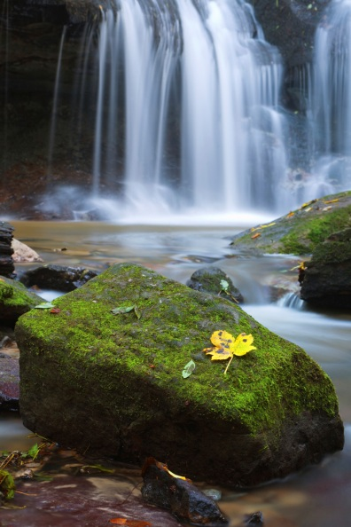
e
Three examples of waterfalls include:
Niagara Waterfall, US/Canada border
Angel Falls, Venezuela, South America
Torc Waterfall, Killarney, Kerry
click
d

Slide 29
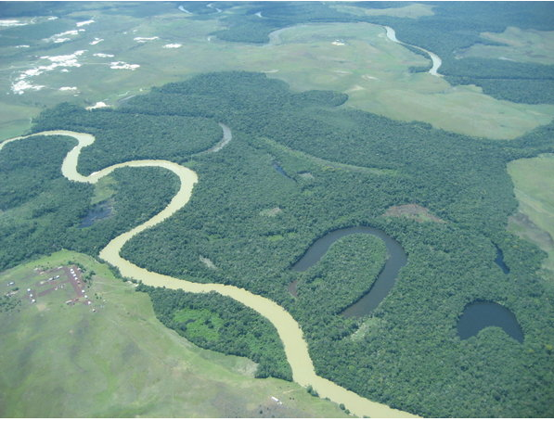
Meanders and Ox Bow lakes
Click title

Slide 30
105

Slide 31
107

Slide 32
Meanders and Ox Bow lakes
f
Meanders and Ox Bow lakes are features of erosion and deposition found in the mature stage of a river.
e
These features are found in the stage of the river where the slope is gentler and the river begins to flow at a slower speed. This may lead to more deposition than erosion. As the river makes its way downslope it begins to move from side to side creating bends or curves. The river bends due to erosion and deposition. The river flows quicker on the outer curve causing erosion in the riverbanks. The faster flowing water creates deeper areas on these curves. On the opposite side the river flows slower due to the shallower waters and deposition occurs. The river drops some of its load on the inner curve creating a build up of material called a point bar. The movement of the river from side to side is called lateral erosion (erosion of the sides of the river banks). Over time the bends become more pronounced. There is a narrow area of land between each bend called a neck. The river does not have much energy to travel around the meander so it cuts through the neck. Over time deposition builds up to cut off the meander. An ox bow lake is now formed. At time continues the lake may dry up to create what is called a ‘mort lake’ or meander scar.

Slide 33
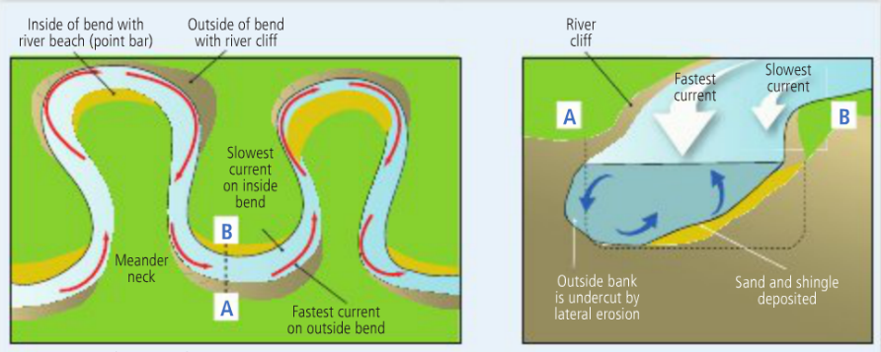

Slide 34
e
Examples of meanders and Ox bow lakes include:
Meanders: River Shannon in Co. Limerick
Ox Bow lakes: River Liffey in Ballymore Eustace, Co. Kildare
Both: Mississippi River, Louisiana, USA
d

Slide 35
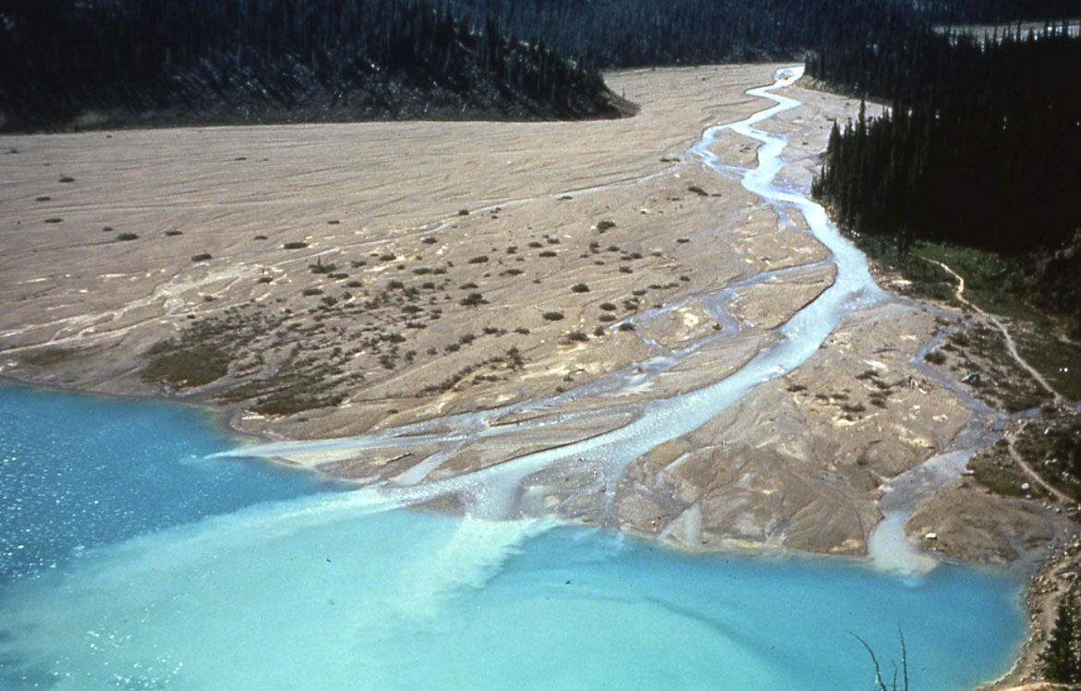
Deltas

Slide 36
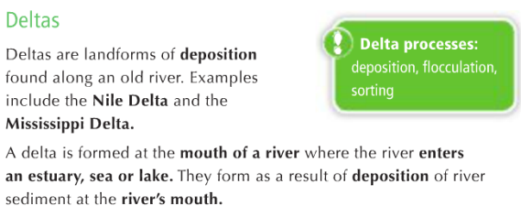
109

Slide 37
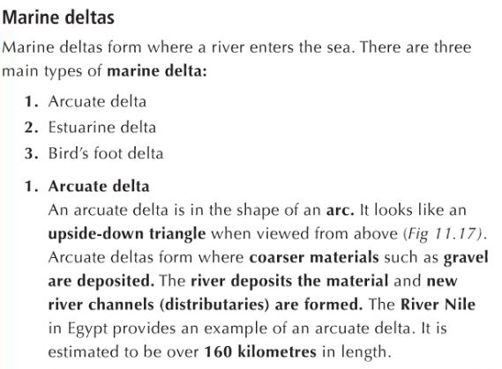

Slide 39
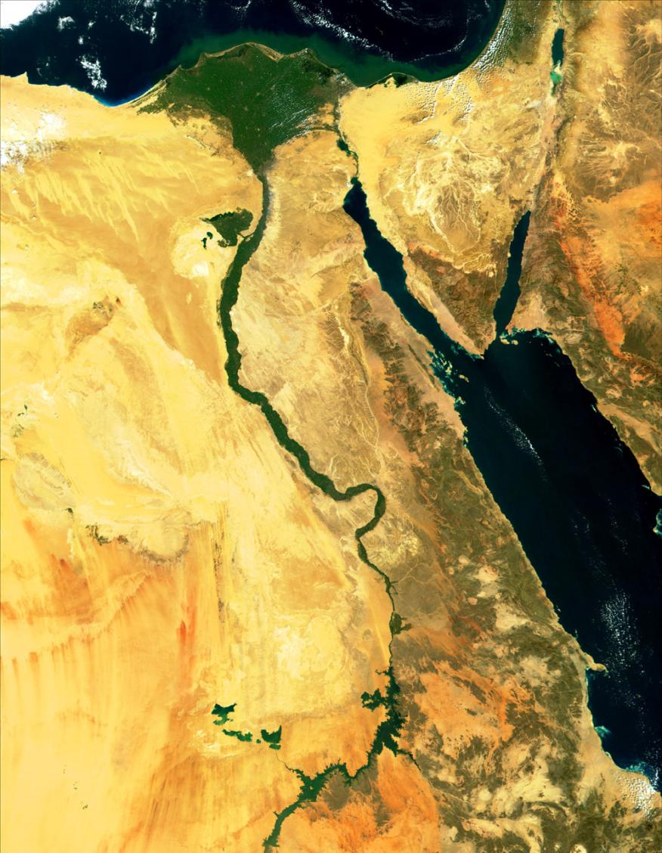
Chapter 11: Fluvial Processes, Patterns and Landforms, & Human Interaction
Features of old river (continued)
IV. Deltas
Formed at the mouth of a river where the river enters an estuary, sea or lake
River loses speed and its energy to transport recedes
Deposition of alluvium
Alluvium build ups and become visible above the water
Material dropped in three layers:
Bottomset beds =fine deposits – are carried/transported out furthest to sea
Foreset beds =coarser deposits – are deposited close to the river mouth
Topset beds = some fine, some coarser, e.g. silt and sand

Slide 40
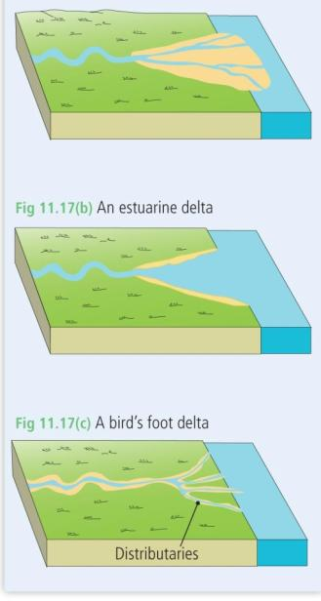
Chapter 11: Fluvial Processes, Patterns and Landforms, & Human Interaction
Features of old river (continued)
IV. Deltas
Lacustine deltas form where rivers enter lakes
Marine deltas form where rivers enter the sea. There are three main types of marine delta:
Arcuate delta
Estuarine delta
Bird’s foot delta

Slide 41
Deltas
f
e

Slide 42
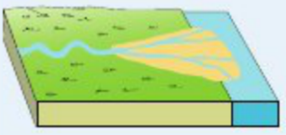
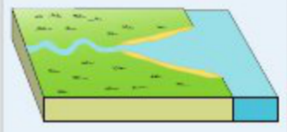
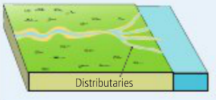
e
Three examples of deltas include:
d

Slide 43
Other river features to read…
Interlocking spurs and V-shaped valleys
Levees
Flood plains

Slide 44
River drainage patterns

Slide 45
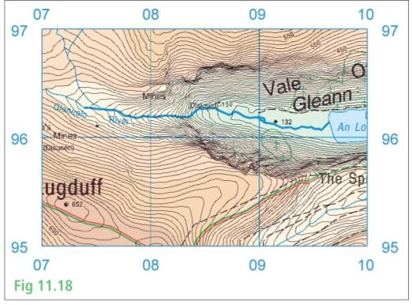
Chapter 11: Fluvial Processes, Patterns and Landforms, & Human Interaction
River drainage patterns
Dendritic pattern
Radial pattern
Trellis pattern
Deranged pattern

Slide 46
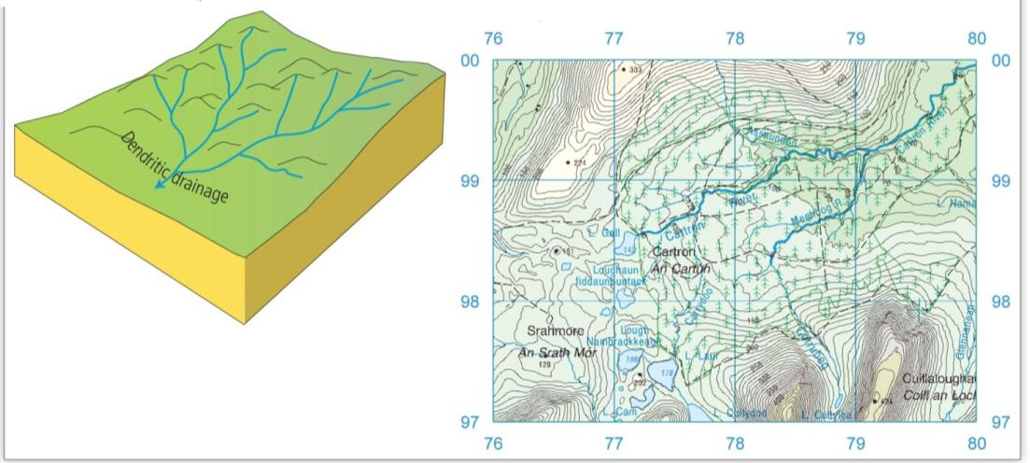
Chapter 11: Fluvial Processes, Patterns and Landforms, & Human Interaction
1. Dendritic pattern
Similar in appearance to a tree
Develops in areas that have rocks of equal hardness
Develop where the river follows the slope of the physical landscape
Tributaries join the main river at an acute angle; less than 90°

Slide 47
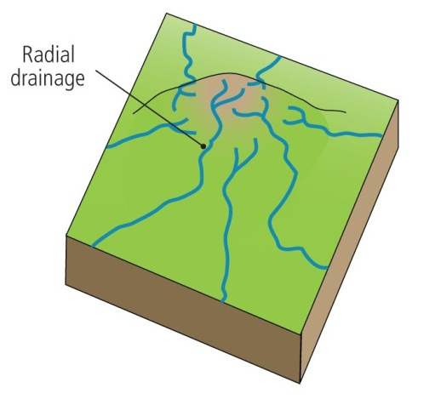
Chapter 11: Fluvial Processes, Patterns and Landforms, & Human Interaction
2. Radial pattern
Similar in appearance to the spokes of a wheel
Rivers radiate down from a central apex on the top of a mountain

Slide 48
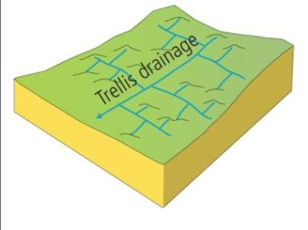
Chapter 11: Fluvial Processes, Patterns and Landforms, & Human Interaction
3. Trellis pattern
Occurs where rivers have tributaries joining the main river at right angles in areas that have rocks of unequal hardness, i.e. areas of hard and soft rock
Differential erosion occurs where soft rock is eroded easily and faster than hard resistant rock
Forms in areas that have experienced folding, such as the Munster Ridge and Valley Province
The River Blackwater is a river found in this area and its tributaries join onto it at right angles

Slide 49
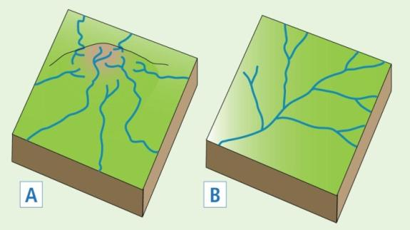
Chapter 11: Fluvial Processes, Patterns and Landforms, & Human Interaction
4. Deranged pattern
Occurs where glaciation has impacted on the landscape
Rivers are irregular in their pattern/appearance

Slide 50
Human interaction with rivers

Slide 51
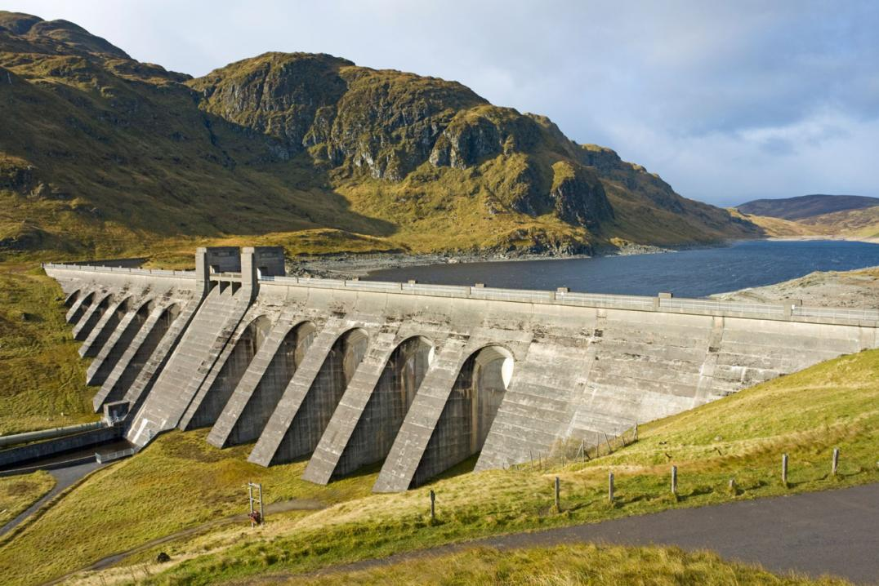
Chapter 11: Fluvial Processes, Patterns and Landforms, & Human Interaction
Impact of human activity on river processes
1. Hydro-electric dams
Positive
Generation of electricity
Supply of water
Controlling the effects of flooding
The reservoir can be used for recreational purposes and also for aquaculture
Negative
Relocation of people
Natural flooding does not occur down river
Reduction in the number of species living in the river ecosystem

Slide 52
Chapter 11: Fluvial Processes, Patterns and Landforms, & Human Interaction
Impact of human activity on river processes
2. Canalisation
Positive
Efficient water transport
Irrigation purposes
Flood control measures – levees
Negative
River bank failure
Flooding elsewhere along the river course

Slide 53
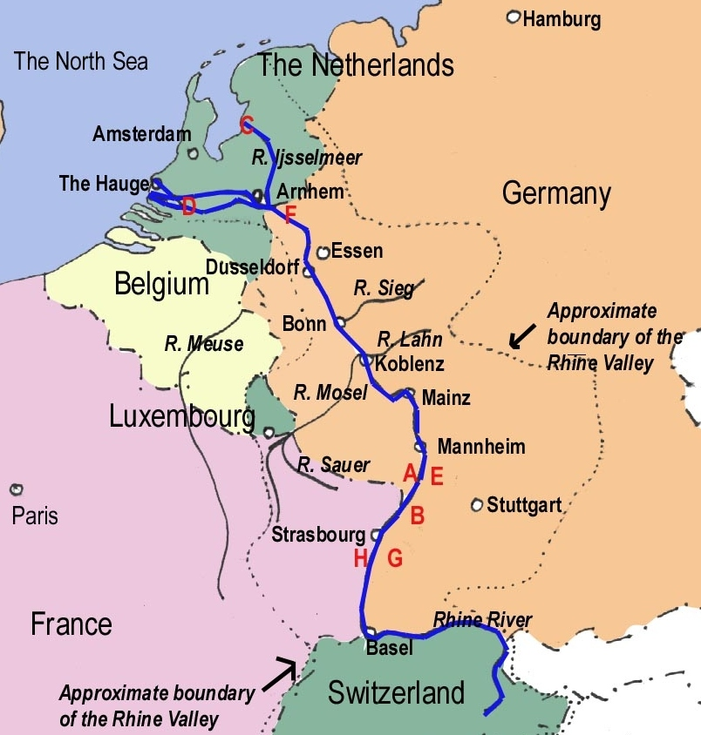
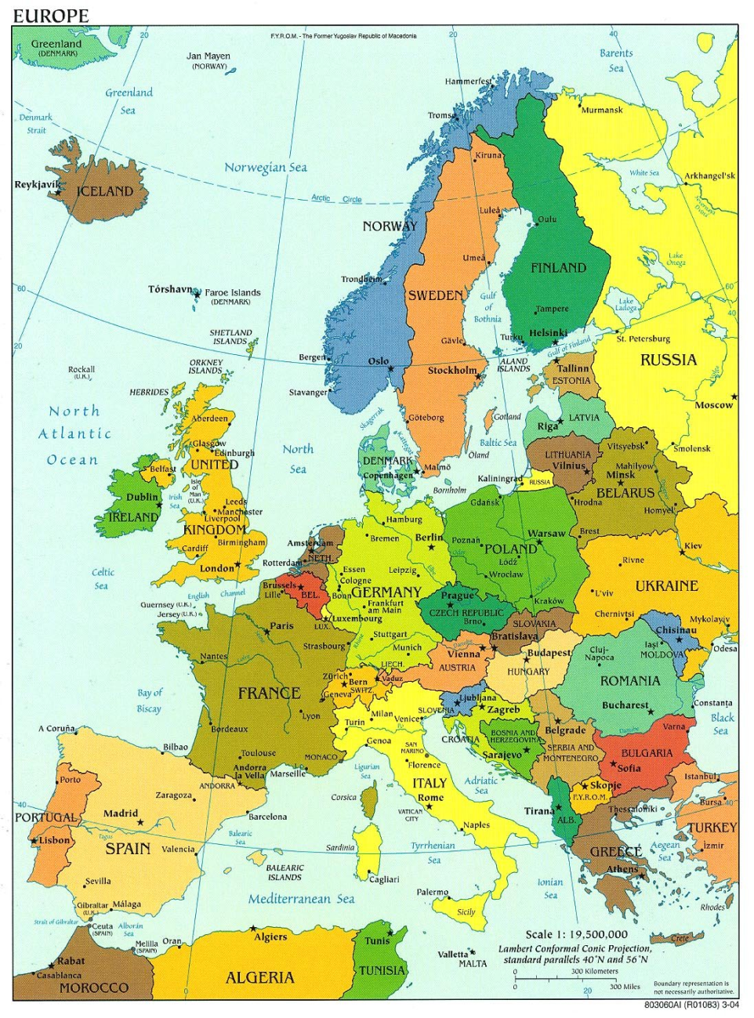
River Rhine, Germany/Europe

Slide 54
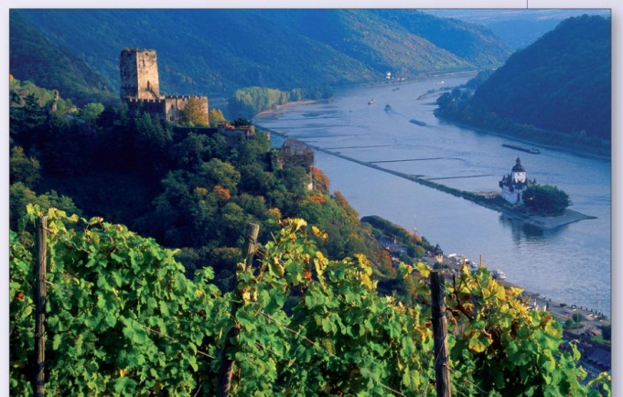
Chapter 11: Fluvial Processes, Patterns and Landforms, & Human Interaction
The River Rhine case study
One of the longest and most important rivers in Europe
Length approximately 1,232 km (766 miles)
Source in the Swiss Alps
Flows through six countries: Switzerland, Liechtenstein, Austria, Germany, France, the Netherlands
Enters the North Sea at Rotterdam, the Netherlands
Main tributaries are the Main, Necker and Moselle

Slide 55
Chapter 11: Fluvial Processes, Patterns and Landforms, & Human Interaction
Features
One of the main traffic arteries of Western Europe
An important means of transporting and shipping
Canal network developed around the river course
Dykes constructed to prevent the likelihood of flooding
Meanders bypassed by the construction of new canals and channels
Resulted in a shorter, deeper and straighter river course

Slide 56
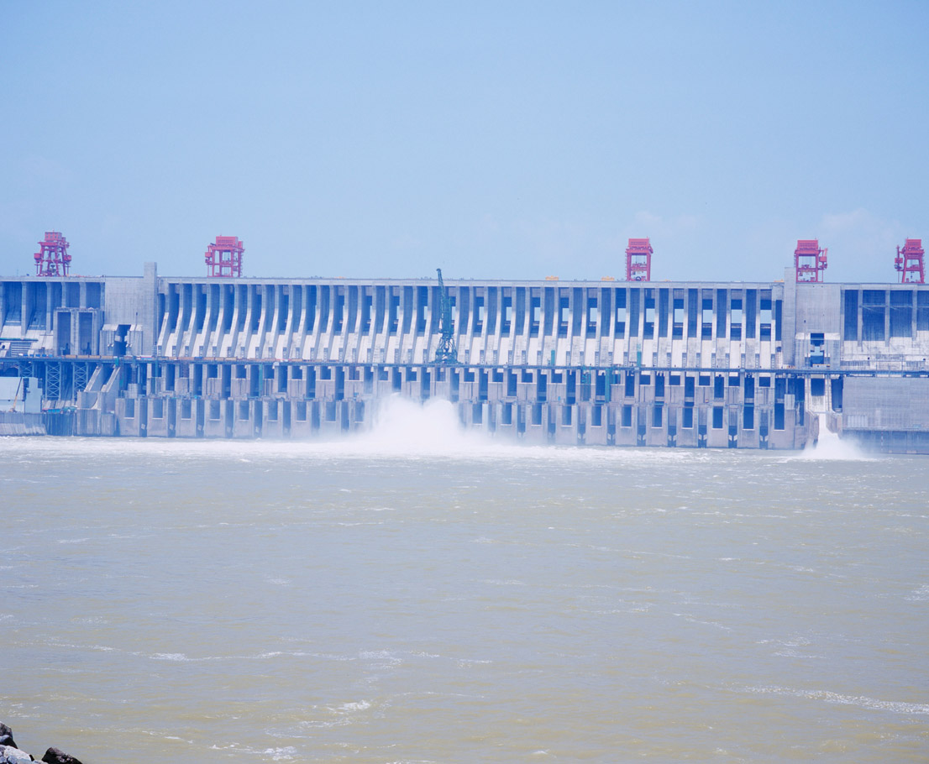
Chapter 11: Fluvial Processes, Patterns and Landforms, & Human Interaction
Impact of changes to river course
Dykes
Land is utilised for agricultural purposes and buildings have also been constructed on the floodplain
Dykes have been constructed and are regularly increased in size to protect the surrounding agricultural land and buildings
Prevent the river flooding over its banks at dyke locations resulting in flooding being transferred further downriver
River cannot deposit onto its floodplain and so deposits sediment onto the river bed
Raises the level of the river
Dykes must be regularly upgraded to match the new river height

Slide 57
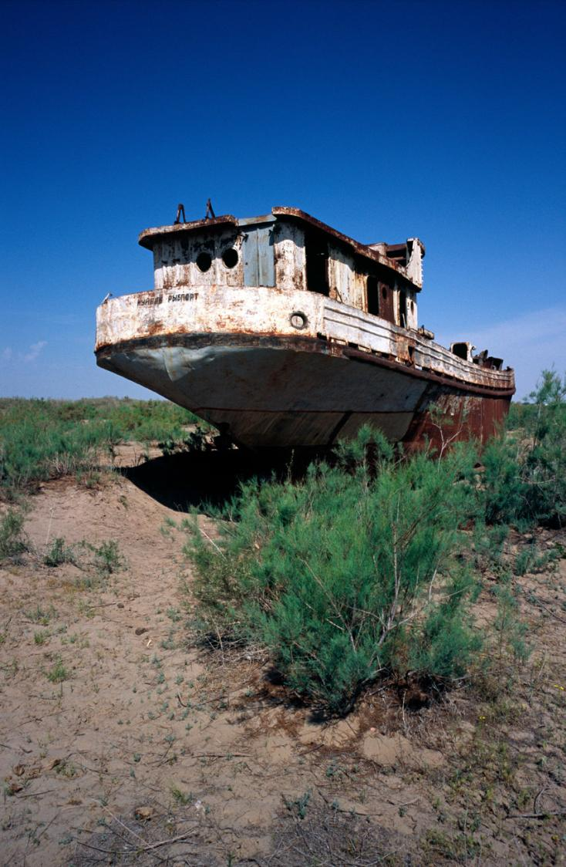
Chapter 11: Fluvial Processes, Patterns and Landforms, & Human Interaction
Impact of changes to river course
Shipping
Areas of the River Rhine were narrowed to create a deeper river channel to allow larger ships to travel through
Rhine travels through polders in the Netherlands between high embankments
Embankments absorb water
Embankments may eventually collapse resulting in the surrounding land being flooded

Slide 58
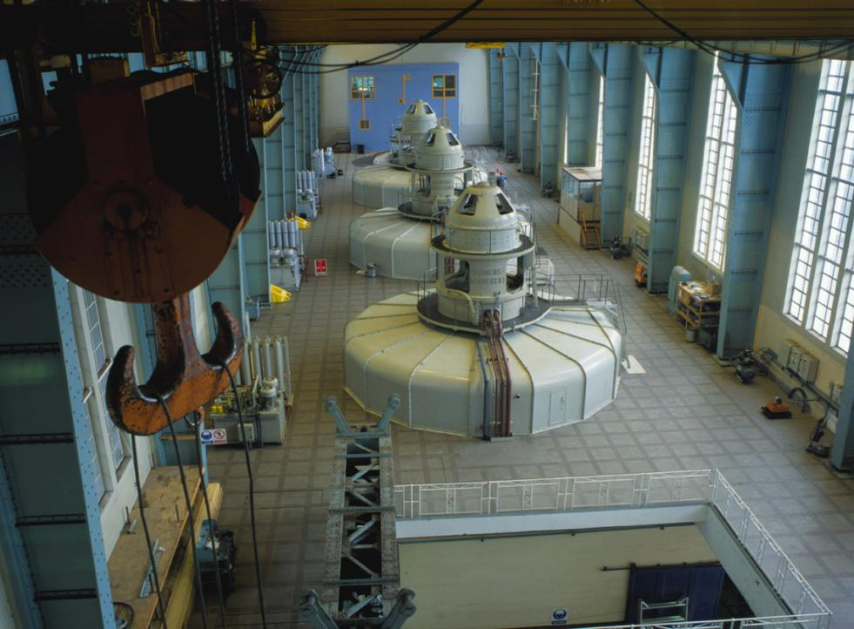
Chapter 11: Fluvial Processes, Patterns and Landforms, & Human Interaction
Impact of changes to river course
HEP
Thirteen hydroelectric power stations constructed along the river
Contributed to increased flooding along the course of the river
Power Project involved the construction of a new section of river running parallel to the old River Rhine course

Slide 59
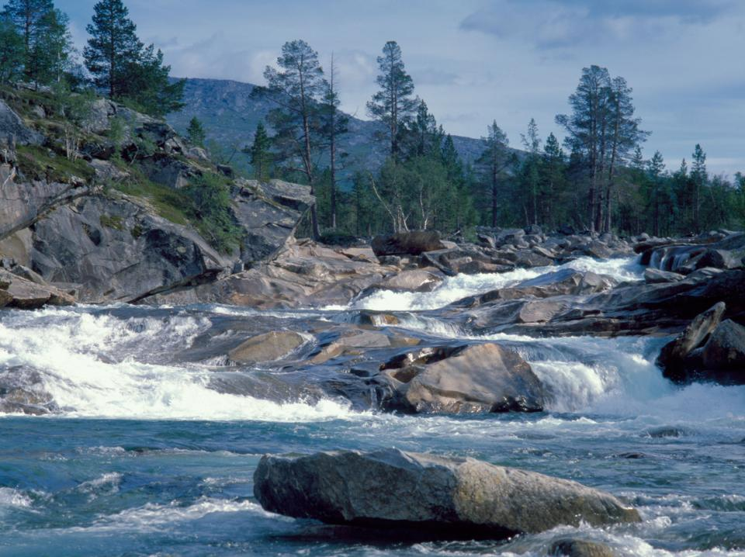
Chapter 11: Fluvial Processes, Patterns and Landforms, & Human Interaction
Outcome of changes to river course
Dams trap sediment, which reduce the rivers load
Created a faster and deeper river
Flooding frequency and water flood levels increased over the last 100 years
Plan to tackle the problem by restoring 100 artificial channels and 11,000 km of river bank

