Slide 1
12 Coastal Processes, Patterns and Associated Landforms, and
Human Interaction
Coastal processes, patterns and associated landforms
Coastal processes and the impact of recreational pressures, coastal defence work, conservation and management measures

Slide 2
Layout of this chapter
Introduction and terms
Processes of erosion
Factors affecting erosion
Features of erosion
Transportation of the seas load
Features of deposition
Case studies, human involvement

Slide 3
Some terms you should know….
Fetch: the distance a wave travels before it reaches land. (the bigger the fetch the bigger the wave).
Coastline: The meeting of land and sea
Shoreline: the area of coastline between high and low tide

Slide 4
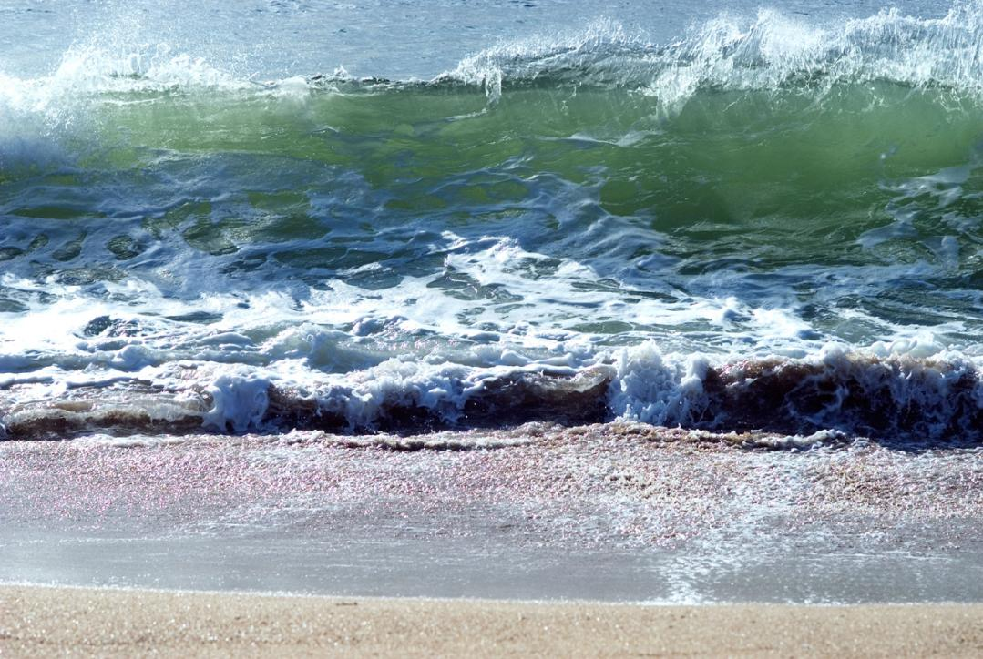
Chapter 12: Coastal Processes, Patterns & Associated Landforms, & Human Interaction
Waves
Responsible for erosion, transportation and deposition of material along coastlines
Generated by wind passing over the surface of the sea
Fetch is the open area of the sea that a wave travels over
The longer the fetch, the stronger the wind speed, the stronger and greater the waves generated

Slide 5
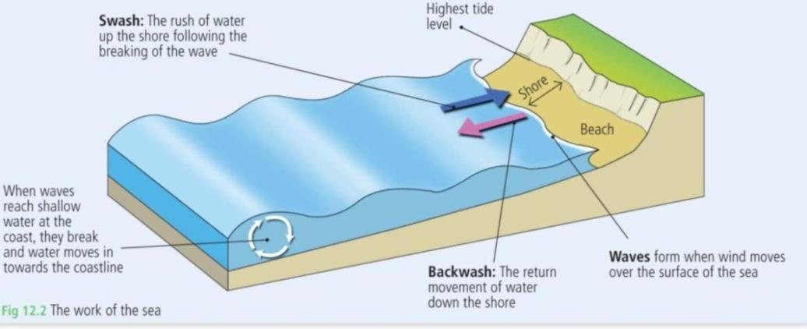
Chapter 12: Coastal Processes, Patterns & Associated Landforms, & Human Interaction
Factors affecting the rate of coastal erosion
Where the breaking of a wave occurs
Steepness of the wave
Rock resistance

Slide 6
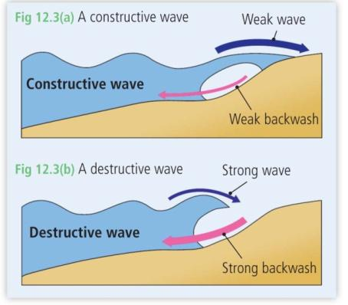
Chapter 12: Coastal Processes, Patterns & Associated Landforms, & Human Interaction
Types of waves
Constructive waves
=deposition
2. Destructive waves
=erosion

Slide 7
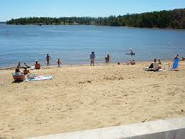
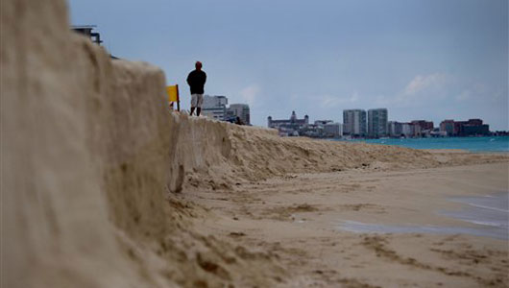
Summary…
Constructive waves wash material up on the coastline because the swash is stronger than the backwash
Destructive waves pull material from the coastline because the backwash is stronger than the swash.
Constructive wave: Deposition
Destructive wave: Erosion

Slide 8
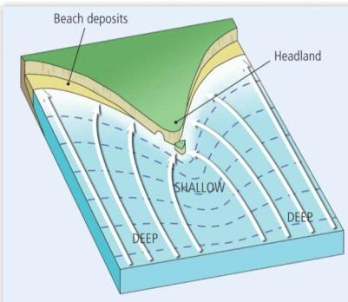
Chapter 12: Coastal Processes, Patterns & Associated Landforms, & Human Interaction
Wave refraction
Waves slow down as water becomes shallow
Waves bend and change their direction as they approach the shore
Causes waves to move towards the headland where their erosive force is released

Slide 9
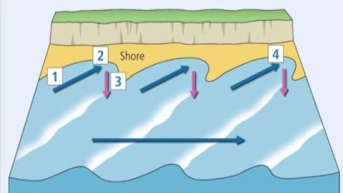
Chapter 12: Coastal Processes, Patterns & Associated Landforms, & Human Interaction
Longshore drift – a process of coastal transportation
The sea transports its load of sand and shingle in two main ways:
Up the shore in swash at an angle
Back down the shore in backwash straight down
=the zig zag movement of material along the coastline

Slide 10
Processes of erosion (how the sea erodes the land it meets)
Hydraulic Action
Abrasion
Compressed air
Attrition
Chemical solution

Slide 11
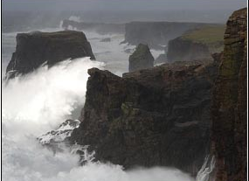
Hydraulic Action
The force of the waves as they pound the coastline.
The greater the fetch, wave and wind the greater the power of the approaching waves.

Slide 12
Abrasion
Abrasion is the wearing away of the coastline by the seas load scraping the sea bed and cliffs.

Slide 13
Compressed air
Approaching waves trap air in the cracks and crevices along the coastline. As the air is trapped it expands and the pressure enlarges the cracks causing the cliff face to shatter.

Slide 14
Attrition
The seas load constantly collides together causing rocks and stones to break down into smaller pieces. Sand is the main result of attrition.

Slide 15
Chemical solution
Salts, minerals and chemicals in the sea water dissolve and decompose rocks along the coastline in a chemical reaction.

Slide 16
Features of erosion

Slide 17
The main features we will study are:
Cliffs
Wave cut platforms (with wave built terraces)
Bays & Headlands
Caves – Arch – Stacks stumps and blowholes

Slide 18
The main features we will study are:
Cliffs
Wave cut platforms (with wave built terraces)
Bays & Headlands
Caves – Arch – Stacks stumps and blowholes

Slide 19
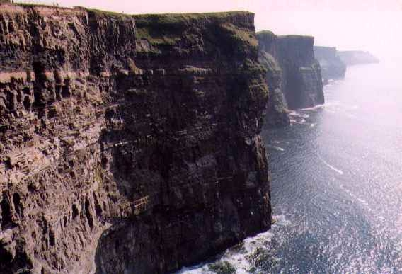
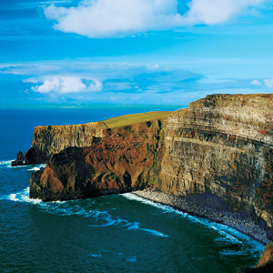
Cliffs
Cliffs
When you think of cliffs….what words pop into your mind?

Slide 20
Cliffs
Steep, notch, overhang, enlarged, unsupported, collapses, debris, removed, sea bed, wave-built terrace, retreat, slumping, wave-cut platform, vertical, sloping, horizontal, dipping, cliff face

Slide 21
Bays and Headlands
F: Feature (name and one sentence introduction)
E: Explain how this feature is formed with at least two processes named and explained as part of the explanation
E: Examples x 3 – with one being Irish
D: Draw / Colour / Label a clear diagram with frame and key

Slide 22
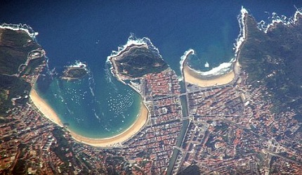

Slide 23
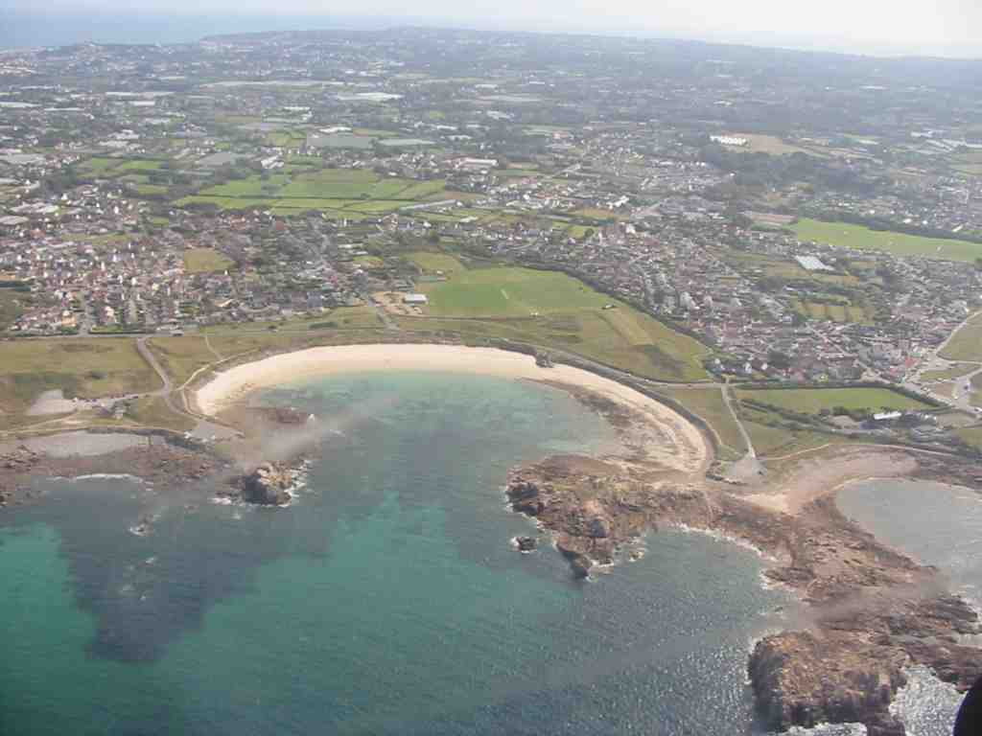

Slide 24
What were the main details
we need to remember?

Slide 25
Explanation
The following details need to be explained in a sentence (each):
Alternative bands of hard and soft rock
Hydraulic action
Abrasion
Wave refraction
Destructive waves
Swash and backwash
Differential erosion
Headlands protect bays
Cycle of erosion

Slide 26
Bays and Headlands
Bays and headlands are features of erosion found along the coastline. Bays are inlets between protruding pieces of land called headlands.
Bays and headlands are found in areas of alternative rock (bands of hard and soft rock). Bays are formed in areas of soft rock while the headlands are areas of hard rock. The main processes of erosion such as hydraulic action (the power and force of the sea pounding the coastline) and abrasion (the scraping of the seas load against the coast) enlarge faults and fissures and cause the coastline to erode. Wave refraction occurs where approaching waves are bent towards the headlands due to the shallow waters found below the headlands. As the soft rock is eroded the headlands actually protect the bays from the most powerful waves by taking the greatest impact of the powerful approaching waves.

Slide 27
In addition the coast is eroded by destructive waves. This is when the backwash is more powerful than the swash removing material from the coastline. As the soft rock is weaker, it is eroded quicker than the resistant hard rock. This is known as differential erosion. This leads to the formation of the bays (inlets) and the remaining protruding hard rock which are headlands. However while the hard rock is stronger than the soft rock it is slowly but surely eroded back and a cycle of erosion begins all over again.

Slide 28
Examples
1: Silver strand, Wicklow
2 Hook Head, Co. Wexford
3 The Algarve, Portugal

Slide 29
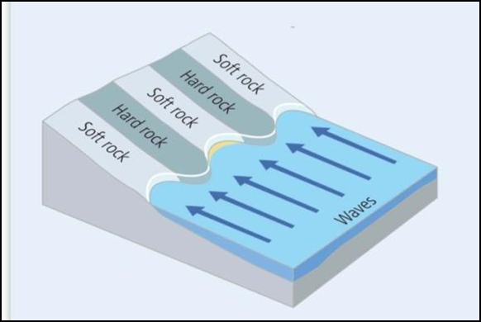
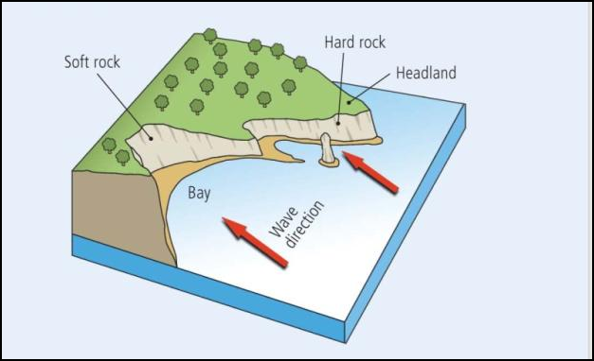
Diagram

Slide 30
Cave, arch, stack,
stump and blowhole

Slide 31
Caves, arches, stacks, stumps and blowholes
o Caves: what are they?
o Type of rock they are formed in
o Why hard rock?
o Hydraulic Action (P)
o Compressed Air (P)
o Weakness in the roof of the cave
o Formation of a blowhole
o Continued erosion on roof and back wall
o Formation of an arch
o Weathering and erosion of the roof of arch
o Creation of a stack
o Erosion of stack
o Abrasion (P) of stack – why
o Creation of a stump

Slide 32
F: Caves, arches, stacks, stumps and blowholes are features of marine erosion found along the coastline.
E: Caves are open hollows usually found near the base of a headland on the cliff face. They tend to form in areas of hard rock along the coastline. Soft rock erodes too quickly for a cave to maintain its shape therefore they tend to form slowly in hard rock and can be deep and large. Caves occur due to the main marine processes of erosion such as hydraulic action (the power and the force of the seas waves pounding the coastline) and Compressed air (where air is trapped between the cliff face and the wave and causes the air to expand. This in turn causes the cracks to enlarge and the coastline to erode). Over time the sea will continue to erode the back wall of the cave and in stormy times cracks in the roof of the cave will be further eroded by solution and compressed air. This creates an area of weakness such as a tunnel or vent in the roof all the way to the surface of the headland. If a vent opens from the roof of the cave to the top of a headland a blowhole is now formed.

Slide 33
During times of high tide or storms water will force its way up the vent and spray out on the surface. As this feature is formed the cave continues to erode backwards through the headland. Sometimes one cave will erode the whole way through or sometimes two caves will meet from either side of the headland. As this happens an arch is formed. However, the roof of the arch (with the blowhole) is weakened and continuous erosion will cause the roof to collapse. Once an arch collapse the headland appears smaller and the remaining outer wall is called a stack. However there is an increase of broken rocks and debris in the area and the processes of abrasion (the scraping of the seas load against the coastline) will continue to erode the stack. Over time it is eroded down to a stump. This is an area of rock barely visible over the waves and dangerous for incoming boats.
The creation of these features are responsible for the coastline appearing to ‘retreat’ and appear smaller on maps/photographs.

Slide 34
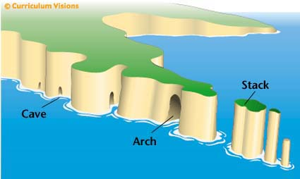
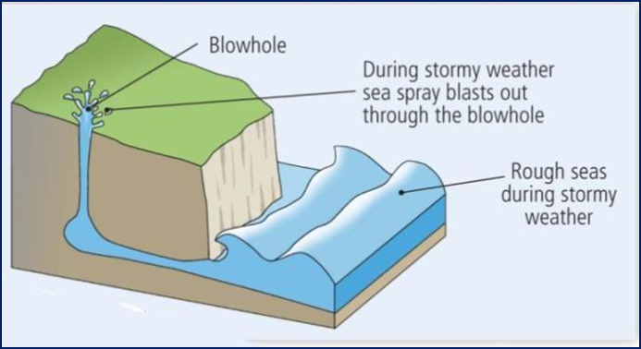

Slide 35
Transport

Slide 36
Longshore Drift

Slide 37
Longshore Drift is the movement of the seas load along the coastline in a zig zag manner.
This happens because the waves approach the coastline at a right angle but flow back down the coastline in a perpendicular direction. By this change of movement the material is carried from one site on the coast to another.

Slide 38
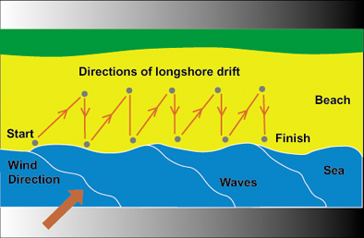

Slide 39
Features of deposition

Slide 40
The main features of deposition are:
Beaches
Bars
Spits
Tombolos

Slide 41
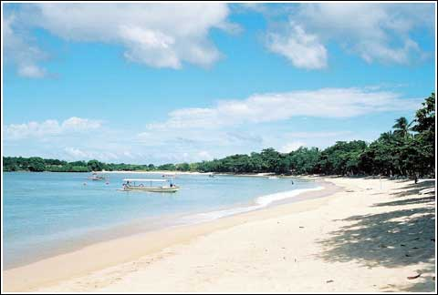
The main features of deposition are:
Beaches
Bars
Spits
Tombolos

Slide 42
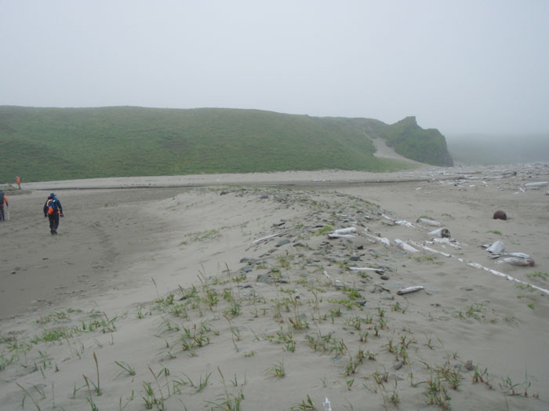

Slide 43
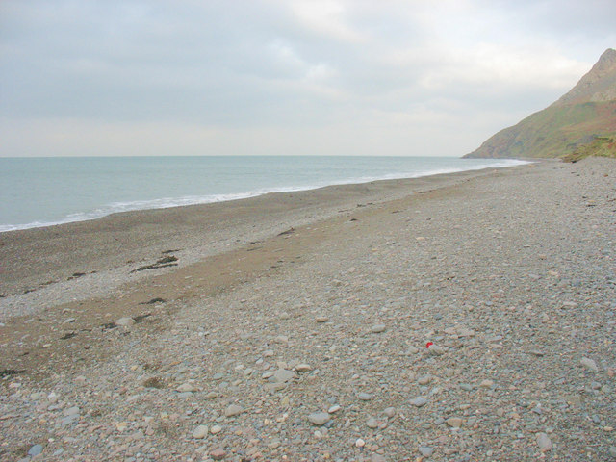

Slide 44
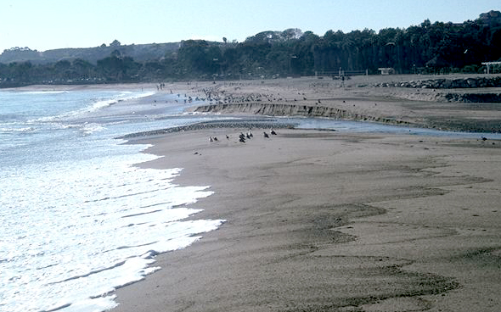

Slide 45
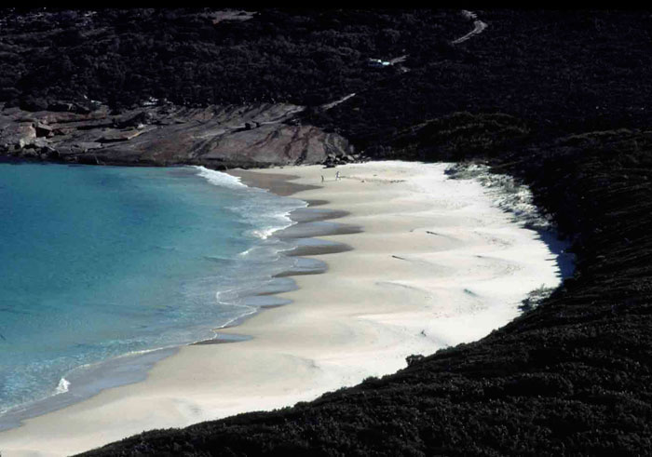

Slide 46
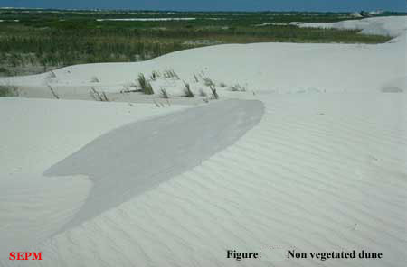

Slide 47
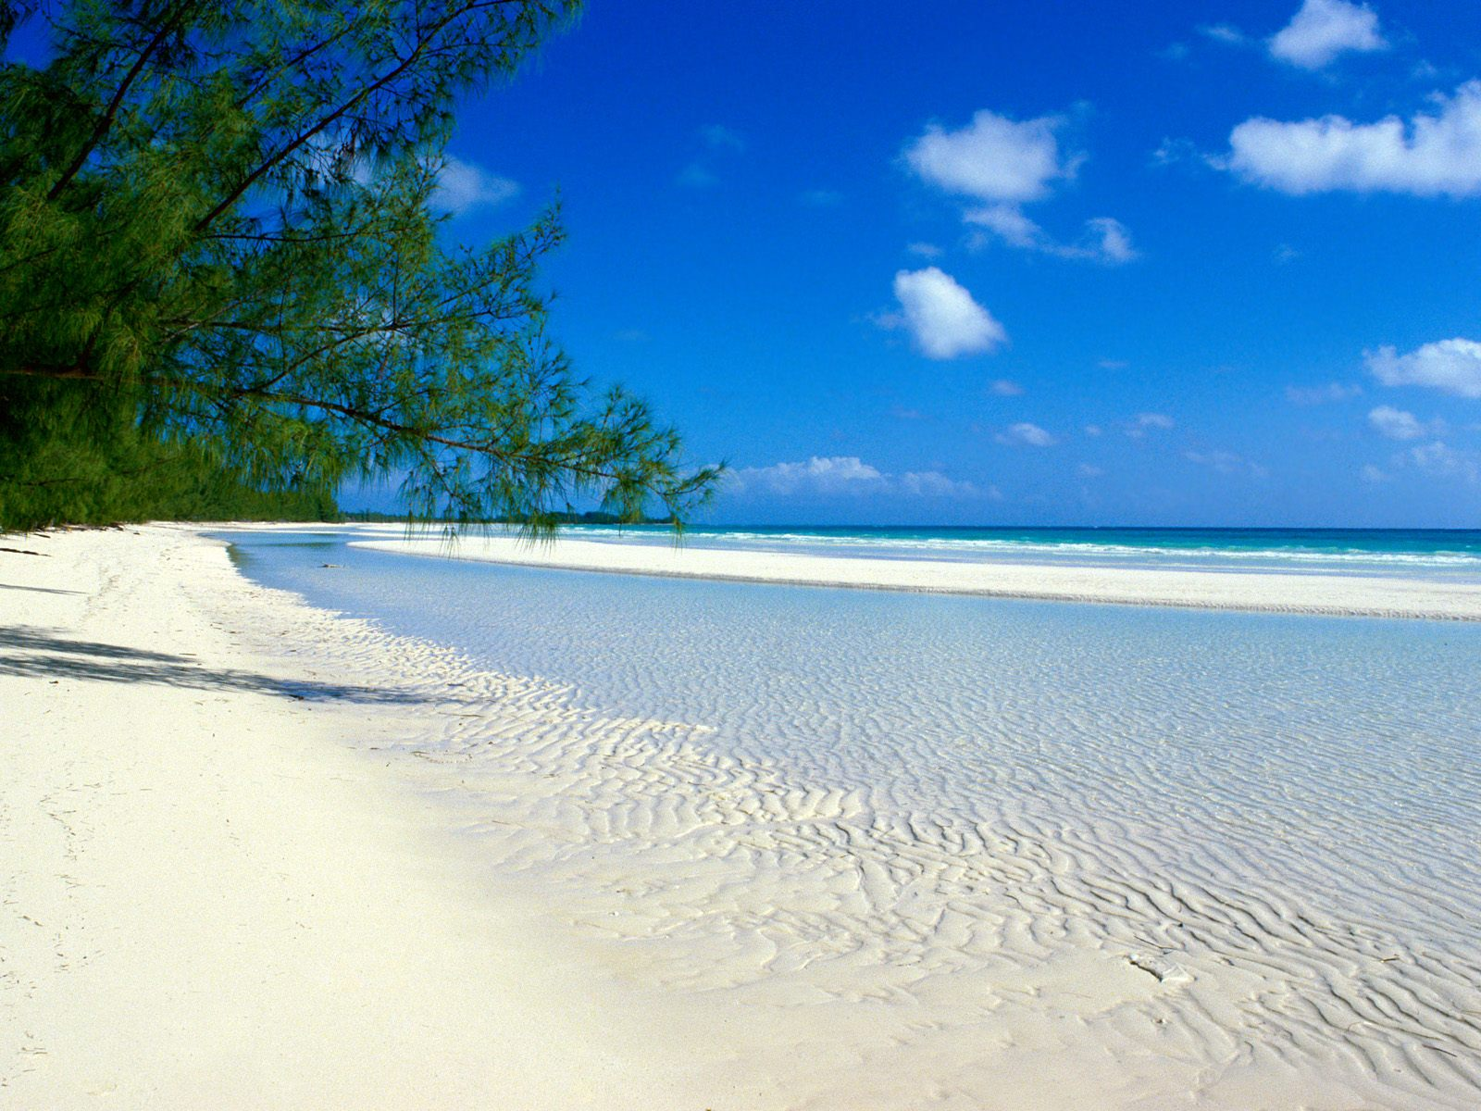
What, where, waves, material, areas, shapes/features,examples and diagram

Slide 48
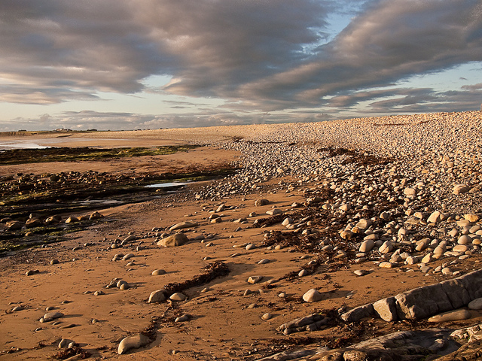

Slide 49
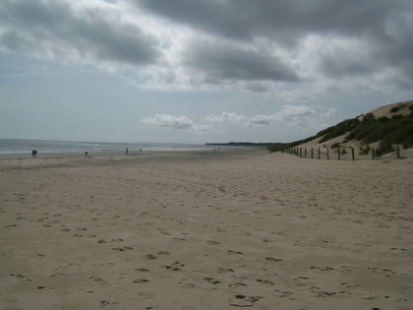

Slide 50
Beaches
Beaches are features of deposition found in coastal areas between high and low tide.
They are generally found in areas where there is an inlet or sheltered area, between headlands or a change in the coastline which causes sediment to be trapped and build up. If a beach is found in a bay it is called a bay head beach.
Beaches are areas of sand, shingle and larger stones. They are created by a number of factors:
Constructive waves are waves that create coastal features. The swash is more powerful than the backwash and material is pushed up the coastline. As the wave flows back down the coastline much of the water percolates down through the sand and the backwash does not have enough energy to remove much material.
Longshore drift is the movement of material along the coastline in a zig-zag manner. The waves approach the beach at an angle but return in a straight manner and sediment is carried along by this process until it is interrupted by a headland or change in coastline.

Slide 51
Beaches can be divided into three main areas:
Foreshore: the part of the beach closest to the water. Here features such as runnels and ridges may be found. These are long rises and depressions in the sand parallel to the coastline and formed by constructive waves breaking.
The middle shore is the part of the beach where ripple marks are found. These are gentle lines in the sand created by the swash. Beach cusps may also be found here. These are crescent shaped hollows in the beach where you tend to find the shingle changes to softer sand. Berms are long, narrow ridges of stones and shingles which tend to mark the dividing point of the middle shore and backshore. This tends to be the area that the waves reach when the tide is in.
Finally the backshore is the area where the storm beach, sand dunes and cliff face are found. A storm beach is the area where strong waves have moved larger pieces of material up the beach. Some beaches have natural or man-made dunes (mounds of sand usually anchored by marram grass) and some have boulder clay or rocky cliffs marking the end of the beach.

Slide 52
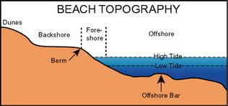
Examples of beaches include:
Curracloe, Co. Wexford
Bondi Beach, Sydney, Australia
Salthill, Co. Galway

Slide 53
Revision time

Slide 54
Summary of main beach points
Can you answer the following:
Name of feature?
Main areas you would find this feature?
Type of wave that makes this feature?
Main process of transportation?
Longer word for ‘seeping’ of water through sand?
Three areas of a beach?
Features you would find in each area of beach?
Three examples of a beach?

Slide 55
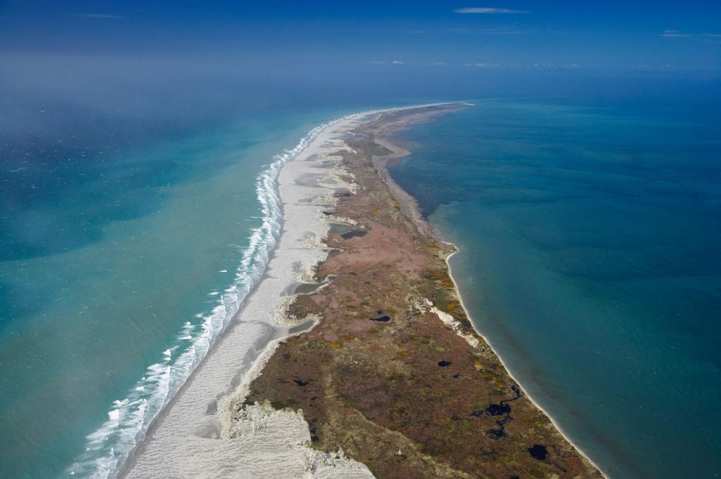
Chapter 12: Coastal Processes, Patterns & Associated Landforms, & Human Interaction
Landforms of coastal deposition
2. Sand spit
A sand spit is a long narrow ridge of deposited sand and shingle that is connected to the coast at one end
Sand spits develop due to longshore drift and deposition
Sand spits form where the process of longshore drift is interrupted
Sediment is deposited in sheltered and shallow water
Over time this sediment builds up and becomes visible above the level of the sea

Slide 56
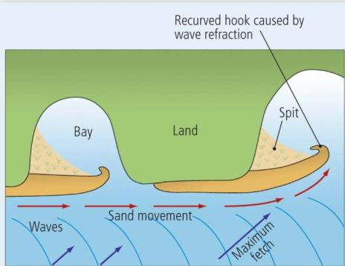
Chapter 12: Coastal Processes, Patterns & Associated Landforms, & Human Interaction
Landforms of coastal deposition
2. Sand spit (continued)
On the seaward side of the sand spit constructive waves deposit fine sediment such as sand and form a beach
Over time the sand spit gets wider
As sand spits grow the area of water behind it is often then sheltered by waves and wind
This often leads to the formation of a salt marsh
Wave refraction may occur at the end of a sand spit which results in the sediment being carried around the end of the sand spit to form a recurved spit (i.e. hook)

Slide 57
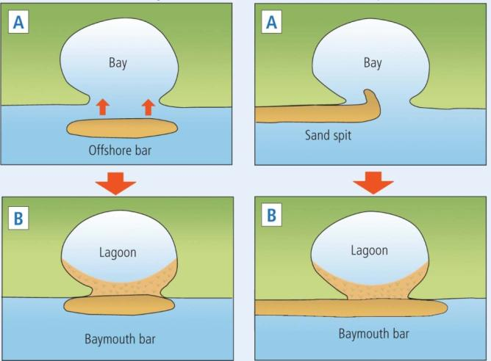
Chapter 12: Coastal Processes, Patterns & Associated Landforms, & Human Interaction
Landforms of coastal deposition
3. Sand bar and lagoon
A sand bar forms when a sand spit extends across a bay and over time connects two land masses
Sand bars will eventually seal off an area of coastline and the water directly behind the sand bar will then be called a lagoon

Slide 58
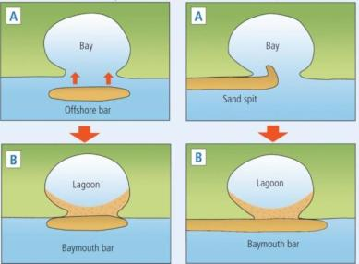
Chapter 12: Coastal Processes, Patterns & Associated Landforms, & Human Interaction
Landforms of coastal deposition
3. Sand bar and lagoon (continued)
There are two types of sand bar:
Offshore bar
Located away from the coastline
Parallel to the coastline
Generally only exposed at times of low tide
Breaking waves deposit sand on the offshore bar
Size of the offshore bar increases over time
May eventually block or close off the bay creating a lagoon

Slide 59
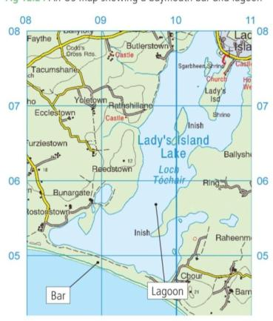
Chapter 12: Coastal Processes, Patterns & Associated Landforms, & Human Interaction
Landforms of coastal deposition
3. Sand bar and lagoon (continued)
2. Baymouth bar
Sand spit extends from one side of a landmass across a bay and reaches the other landmass
Blocks/closes off the bay

Slide 60
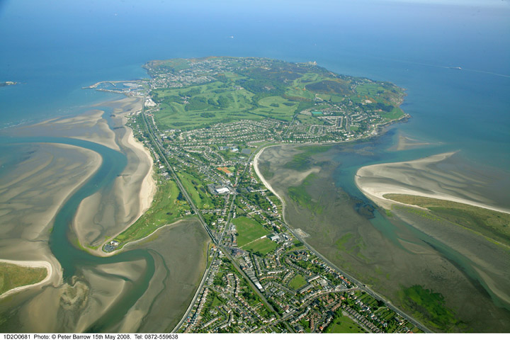
Chapter 12: Coastal Processes, Patterns & Associated Landforms, & Human Interaction
Landforms of coastal deposition
4. Tombolo
Tombolos are formed due to wave refraction and longshore drift
Result from a sand spit extending out to an island and connecting the island to the mainland
Waves approach the island, wave refraction occurs
Sediment is deposited
Results in the spit connecting the island to the mainland and – a tombolo is formed

Slide 62
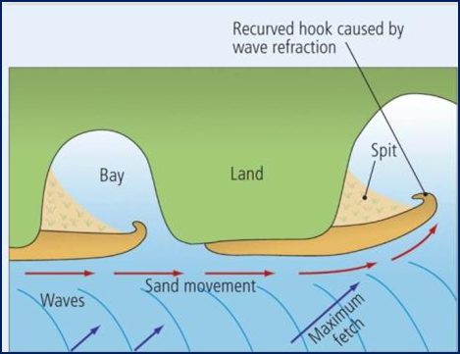
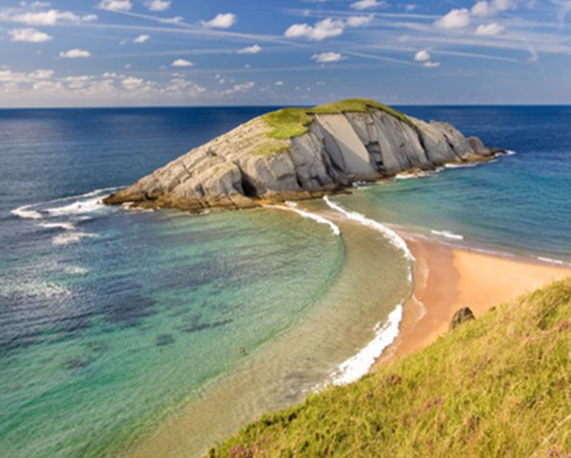
Spits | Bars | Tombolos

Slide 63
Human activities

Slide 64
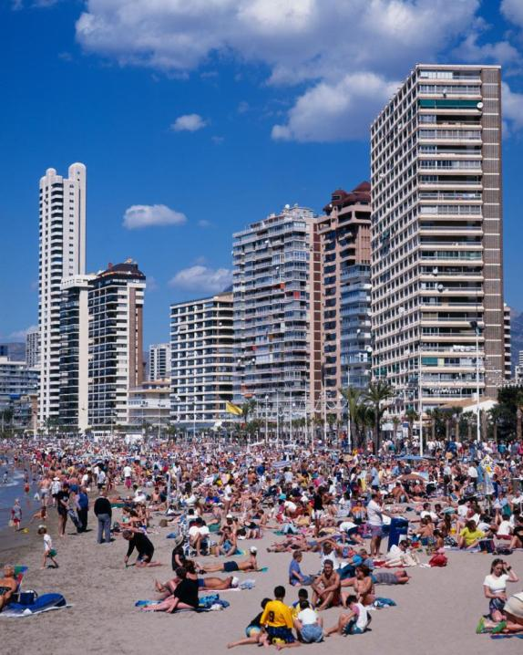
Chapter 12: Coastal Processes, Patterns & Associated Landforms, & Human Interaction
Human activities can impact on the operation of coastal processes
The impact of recreational pressures
Caravan parks, camping sites and hotels or even apartments may be unwisely and hastily built
Sand dunes damaged
Sewage and litter
Pollution

Slide 65
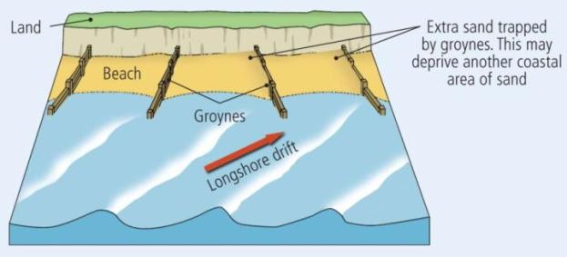
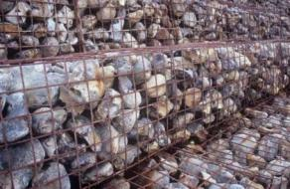
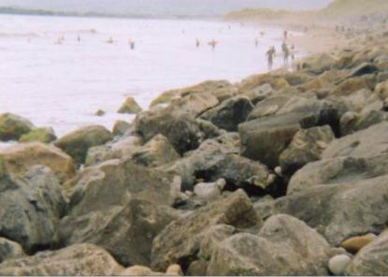
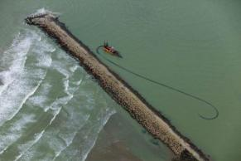
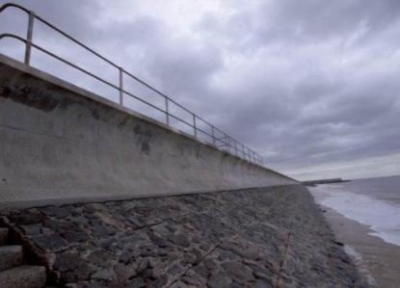
Chapter 12: Coastal Processes, Patterns & Associated Landforms, & Human Interaction
Coastal defence work
Groynes
Rock armour
Sea walls
Breakwaters
Gabions

Slide 66
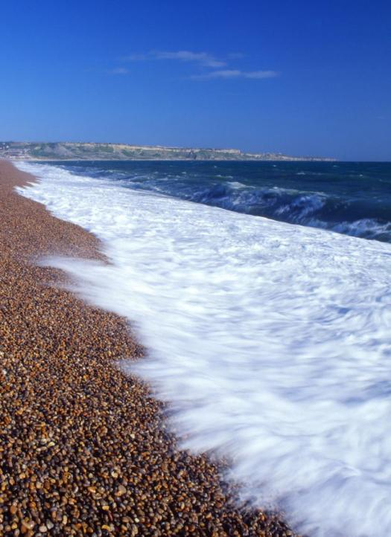
Chapter 12: Coastal Processes, Patterns & Associated Landforms, & Human Interaction
Conservation and management case study
Increasing rates of coastal erosion may be attributed
to a number of factors:
Rising sea levels
Increasing storm frequency
Increasing wave energy

Slide 67
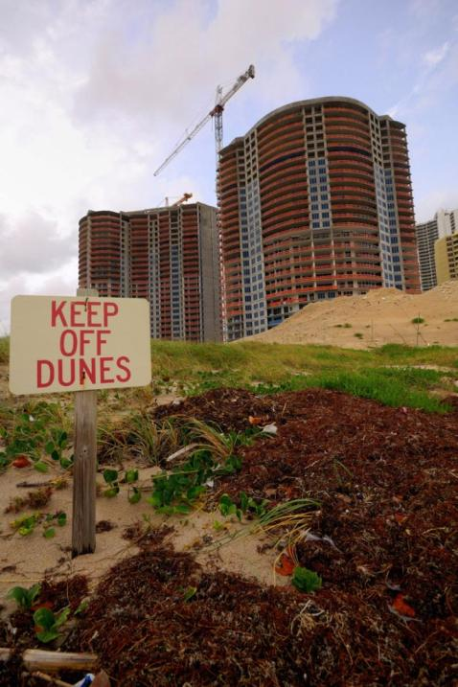
Chapter 12: Coastal Processes, Patterns & Associated Landforms, & Human Interaction
Erosion may be caused by the following:
People
Nature

Slide 68
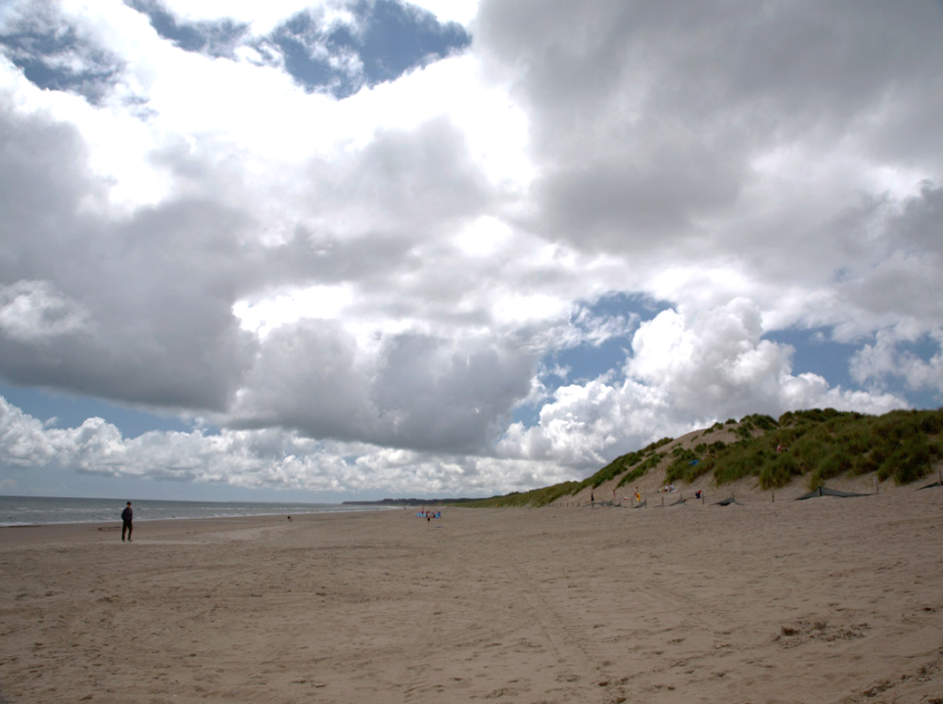
Chapter 12: Coastal Processes, Patterns & Associated Landforms, & Human Interaction
Advantages of beach nourishment
Restores and widens existing beaches
Infrastructure and property at the back of the beach is protected
Beach nourishment places sand on the beach

Slide 69
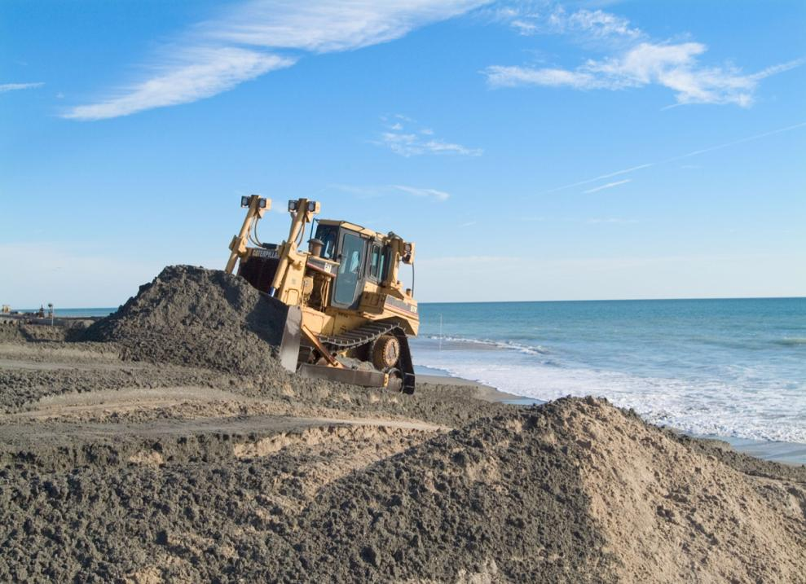
Chapter 12: Coastal Processes, Patterns & Associated Landforms, & Human Interaction
Disadvantages of using beach nourishment
Sand pumped onto beaches through beach nourishment usually erodes faster than the natural sand
Expensive and must be repeated
Visitors and marine life impacted during beach nourishment pumping

Slide 70
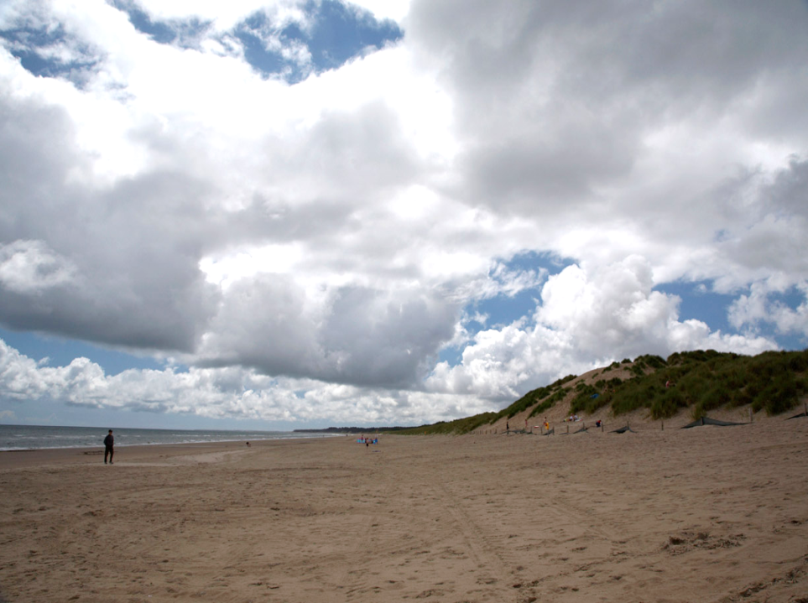
Chapter 12: Coastal Processes, Patterns & Associated Landforms, & Human Interaction
Sand dune management
Erosion and damage may be caused by the following:
Wind
Water
Human activity

Slide 71
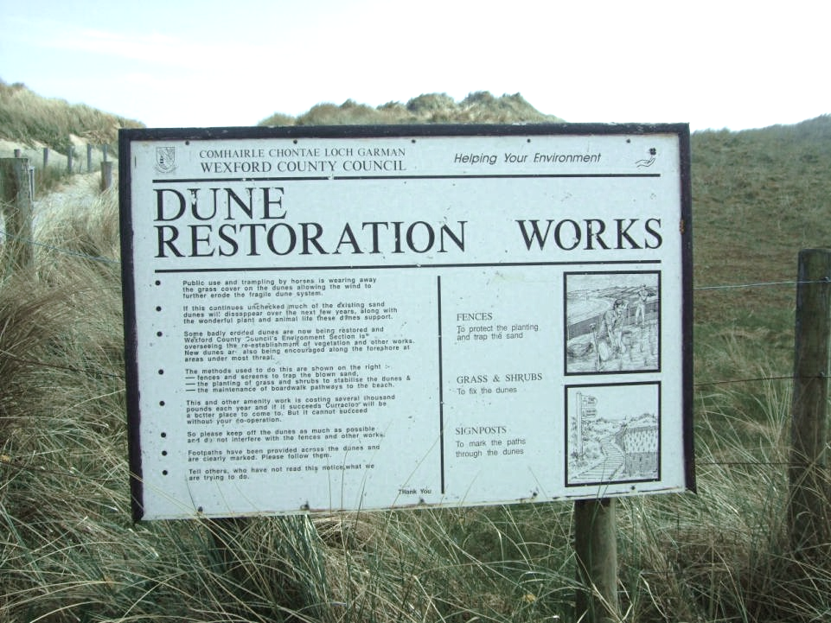
Chapter 12: Coastal Processes, Patterns & Associated Landforms, & Human Interaction
Protection of sand dunes
The action taken includes the following:
Planting/re-establishment of vegetation
New sand dune formation encouraged
Screens and fences trap sand that is blown inland
Grass and shrubs are planted on the sand dunes to ensure stability
Timber pathways laid down

Slide 72
Chapter Summary
Terms: Shoreline, coastline, fetch
Processes: Longshore drift, Constructive waves, destructive waves, wave refraction
Processes of erosion: Hydraulic action, abrasion, attrition, solution, compressed air.
Features of erosion: Cliffs, wave cut platform, wave built terrace, cave-arch-stack-stump-blowhole, bays and headlands.
Features of deposition: Beaches, spits, bars, tombolos.
Human activities: groynes, gabion, breakwaters, walls, rock armour, beach nourishment, marram grass, protection.

