Slide 1
Urban problems in developed world cities
Chapter Six

Slide 2
Chapter 6 Summary
4 Main Urban Problems
Traffic congestion
Urban Decay
Absence of Community
Urban Sprawl
Causes and effects of traffic congestion
Three international strategies to improve traffic flow
Four Irish strategies
Urban decay (causes and effects)
Absence of community (causes and effects)
Urban renewal – regeneration – redevelopment
Urban sprawl – causes – effects and consequences
4 case studies to give further information:
Cork
Copenhagen
Paris
Ballymun, Dublin

Slide 3
Chapter aims:
Identify and describe urban problems
Name Irish and international cities with these problems
Name and describe solutions to urban problems

Slide 4
Common Urban Problems
Traffic congestion
Urban decay
Absence of community
Urban sprawl
Air and water pollution and waste disposal

Slide 5
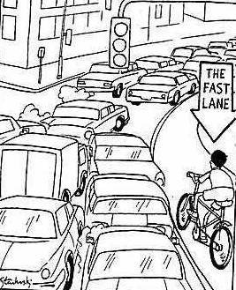
Traffic Congestion
Many cities were built in times when horses and carts were used as transport.
The streets are not wide enough for modern day vehicles.
Public transport systems in many cities are inadequate.
Many people still rely on cars.
Cities cannot cope on ‘car-dependent society’.

Slide 6
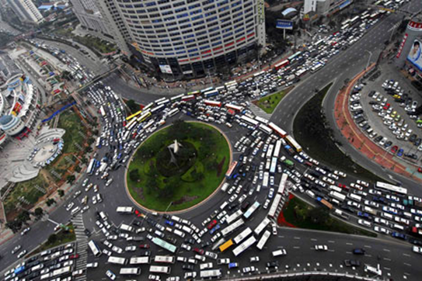
The nine day traffic jam…….

Slide 7
Did you know…..
Commuting rates in Ireland are among the highest in the EU
The average car in Ireland travels more than 25,000km per year.
This is 70% more than France
This is 30% more than the US.

Slide 8
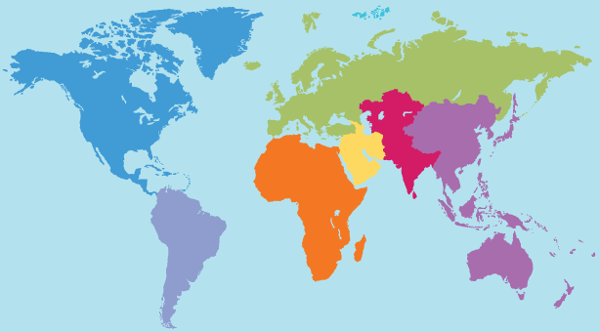

Slide 9
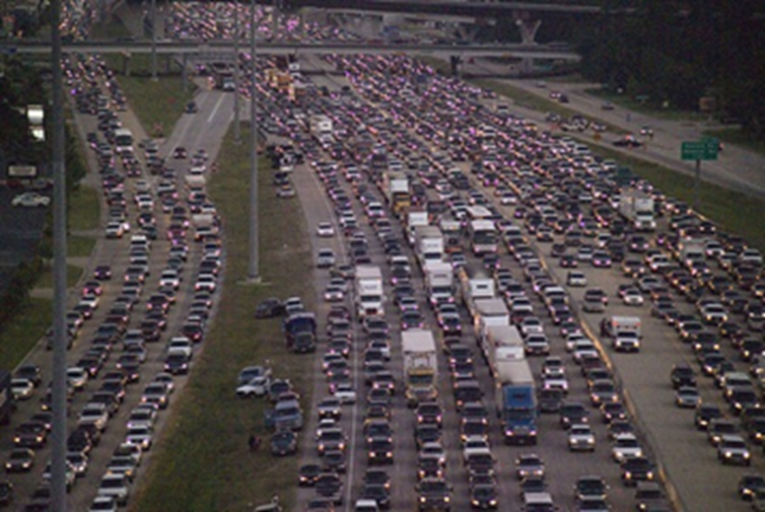
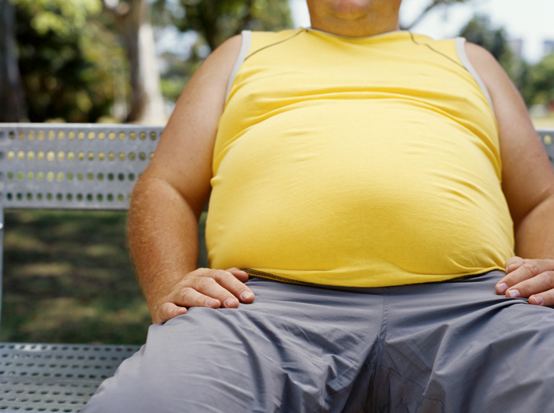

Slide 10
Effects of traffic congestion
Rush hour (morning and evening)
Noise pollution
Stress
Loss of family contact time
Less community spirit
Air pollution (cars running)
Greater risk of traffic accidents
Higher cost of goods due to increased transport times
Health-related problems like asthma
Less time for physical activities
Obesity

Slide 11
Strategies to improve traffic
flow in urban areas
Mexico City
Singapore
London
Ireland

Slide 13
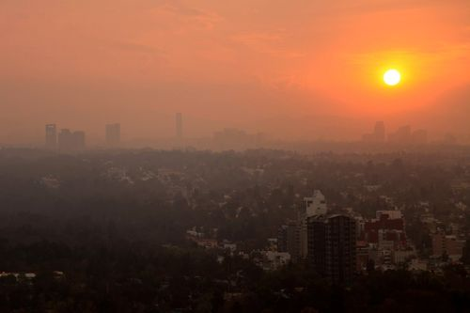
Mexico City, Mexico

Slide 14
Mexico City, Mexico
In the 1990’s the Government launched the ‘No Drive Days’ system where by car owners could not drive in the city on certain days depending on the last digit in their number plate.
Problem: Rich people simply went out and bought a second car to drive on the ‘no drive days’ of the first car!
Problem: Pollution continued to rise and Mexico had the worst rates of air pollution in the world.
Solution? The Government now plans an ‘electronic tag’ system where you have to pay to drive in the city.

Slide 15
Singapore
(1971, revised in 1991)
The Government controls the amount of vehicles sold each year. Each month a quota of cars that can be sold is released.
Members of the public who wish to buy a car must bid for the right to do so!
If their bid is successful they are issued with a COE (certificate of entitlement) which allows them the option to buy a car.
If the car owner wants to keep the car longer than ten years they must renew the certificate.

Slide 16
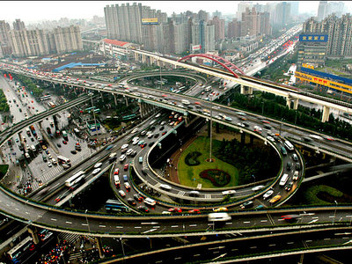
Light traffic in Singapore

Slide 17
London, England
The Congestion Charge was introduced in 2003 to ensure that those congesting the streets of London made a financial contribution.
The charge also aimed to encourage people to use public transport more and their personal car less.
Drivers must pay £8 if they wish to drive in the centre of London between 7am to 6.30pm.
The charges have been increased in recent years as the zones were enlarged and changed.

Slide 18
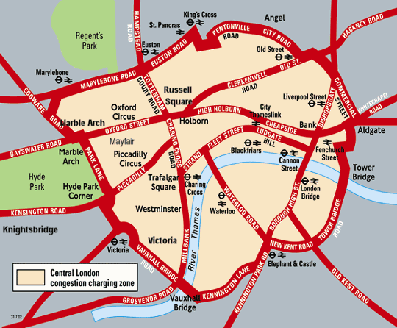
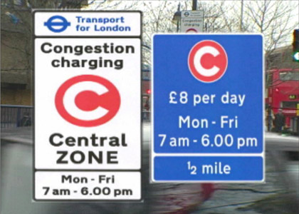

Slide 19
Ireland
T
r
a
f
F
I
C
R
E
S
T
R
I
C
T
I
O
N
s
1
In Dublin (2007) the Government attempted to reduced the amount of HGV’s that were choking the streets of the city each day. To restrict their use of the city centre they:
Banned HGVs (of five axles or more) from the city centre from 7am to 6pm in the evening.
HGV’s of this size had to use the M50 and toll bridge roads instead.
The Dublin Port Tunnel was completed in 2008 which links the Port to the M50…this further reduced the need for HGV’s in the city centre.

Slide 20
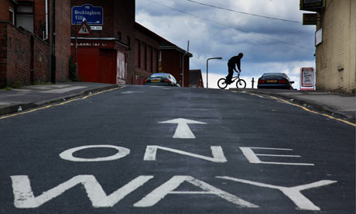
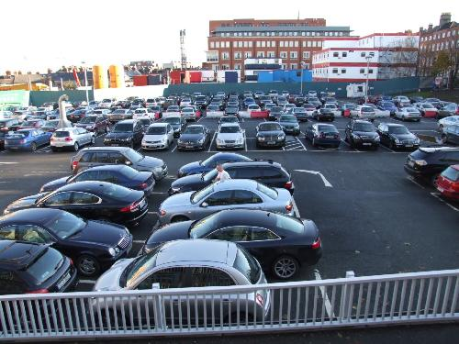
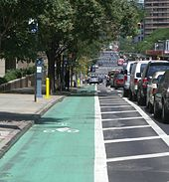
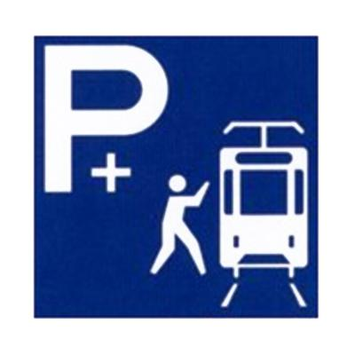
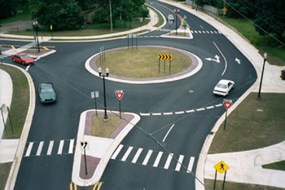
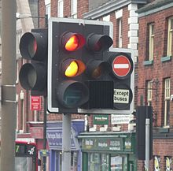
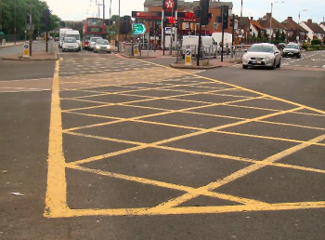
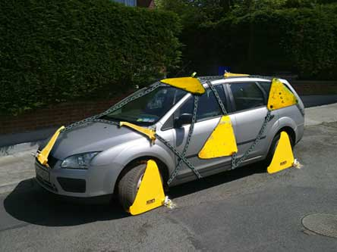
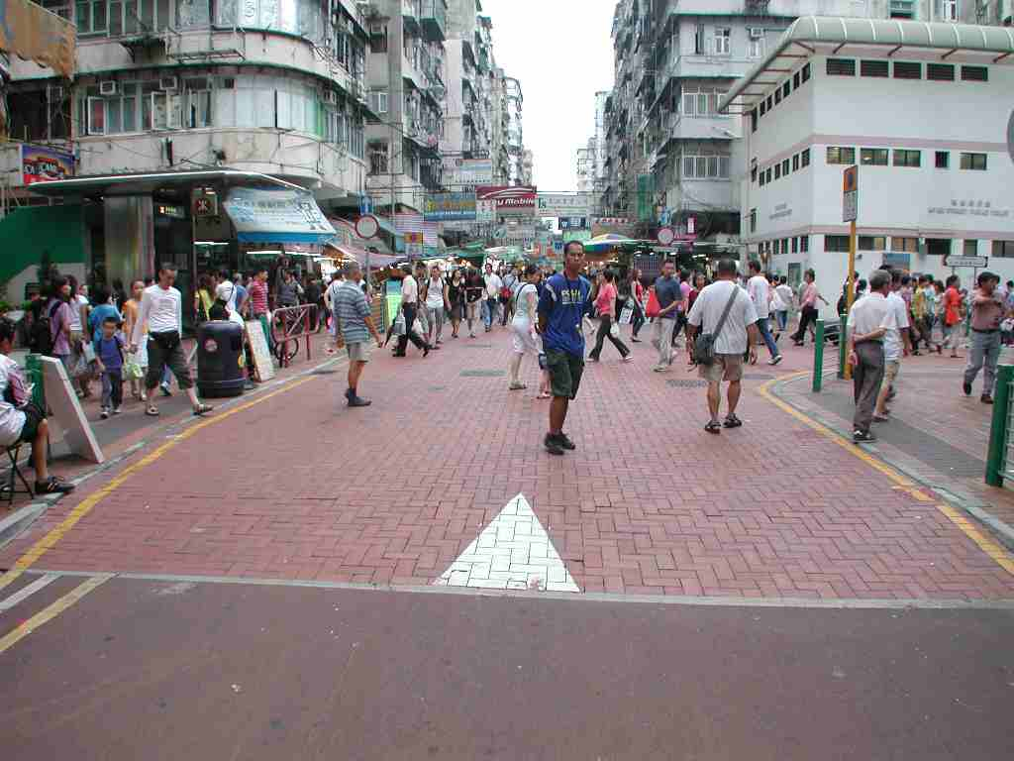
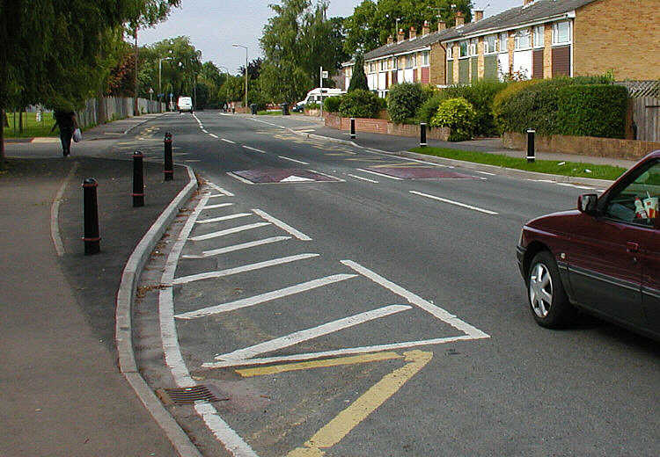

Slide 21
T
r
A
F
F
I
C
M
A
N
A
G
E
M
E
N
T
2
Ireland
Traffic flow is increased and congestion reduced by:
One way streets
Car parks
Cycle lanes
Roundabouts
Traffic lights
Yellow boxes
Clamping and car park restrictions
Park and ride schemes
Pedestrian streets
Traffic calming
methods

Slide 22
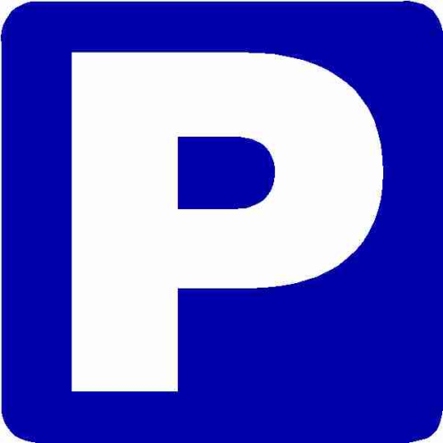
Ireland
3
C
A
R
P
A
R
K
I
N
G
Car parking must be within reasonable distance of the city centre.
So on-street and off-street parking must be effective and available.

Slide 23
Ireland
4
P
U
B
L
I
C
T
R
A
N
S
P
O
R
T
Improving public transport is essential.
The integration of different forms of transport means a successful transport system.
Park and ride facilities encourage car owners to leave the cars outside the city and use public transport.
Bus lanes shortens journey times.
The LUAS and the Dart system further reduces the amount of vehicles in the city centre.
The Transport 21 system aims to improve inter-city links outside of Dublin.

Slide 24
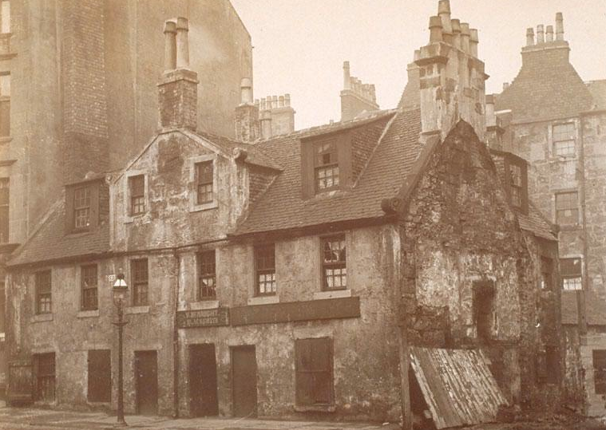
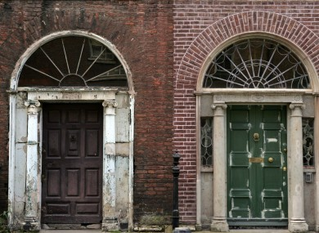
Urban Decay….absence of community
Many older buildings in the city centre need to be demolished or repaired.
These buildings have ancient sanitation, poor heating, damp, rats, leaks, etc etc etc.
The residents experience:
Inadequate public services
Community disruption
Unemployment
Rundown buildings
Isolation

Slide 25
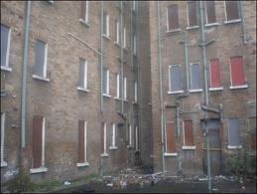
As people are rehoused from the inner city some buildings are demolished but others are left boarded up.
These abandoned buildings attract negative behaviour such as:
Vandalism
Drug dealing/taking
Squats
Crimes
= urban decay
Also, many older industries are leaving their city centre locations and moving to new plants on the outskirts.
This increases the level of unemployment in the city centre.
These city centre locations are often redeveloped such as the IFSC area of Dublin’s Docklands.
No go areas
HARP project

Slide 26
Absence of community
Over the past 60 years residents who used to live in run down parts of the city centre were rehoused in new developments like Tallaght and Ballymun.
However, few knew their new neighbours and felt isolated and alone.
Most of the residents in these new areas were young people with young families….leaving older residents in the city centre.
The elderly residents are unable to fully maintain the buildings and feared going outside.
Crime and anti-social behaviour heightened their fears.

Slide 27
Urban Renewal
Urban renewal = to replace or upgrade decaying buildings.
Renewal is taking place in many Irish towns and cities:
Galway: Eyre Square
Dublin: Liberties, Sherrif Street
Waterford: Quays
Limerick: Moyross, quays
Cork: City centre
Urban Redevelopment = people are moved out of their homes, demolished and rebuilt for commercial uses. (HARP project)

Slide 28
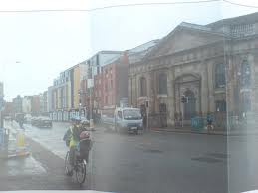
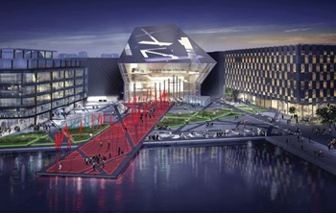
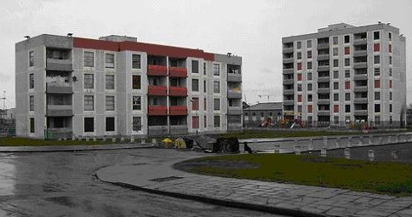
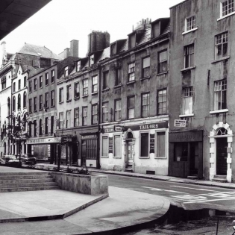
Before
After?
Liberties….Dublin
New flats
Temple Bar

Slide 29
Urban Sprawl
Urban Sprawl: rapid growth of housing from cities into the surrounding countryside.
Causes: Population increase, Celtic Tiger Boom
Consequences: Loss of farmland, greenbelts
Solutions: Use the land more efficiently, renew buildings and land use, plans and strategies.

Slide 30
Case Studies:
Cork City
&
Copenhagen, Denmark
Ten key points on each (dates, locations, plans, proposals etc)

Slide 31
Name the city
Give a date of start/completion/proposal (if possible)
Name the plan and who proposed it
Costing of the plan (if available)
Key aims of the plan
Areas the plan will change/influence
Other main points/problems/concerns

Slide 32
Sample key notes for Cork City:
Cork city and the wider Cork Metropolitan area.
Traffic congestion in and around the streets of Cork City.
CASP: Cork Area Strategic Plan implemented.
Aimed to integrate the transport system by:
Improving/providing key road links
Develop suburban rail network
Provide bus network with park and ride
Improve cycle and pedestrianised aras
Bus network is park of GREEN ROUTES:
Improved footpaths
Pedestrian safety
Cycle lanes and track
Pedestrian crossings
Bus/cycle priority at traffic lights
Estimated €40million from Dept. of Transport

Slide 33
Case Studies:
Ballymun
&
Paris Regeneration
Ten key points on each (dates, locations, plans, proposals etc)

