Slide 1
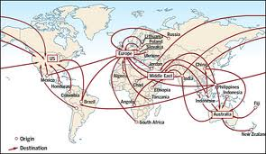
Migration has an impact on receiving regions(host regions) and donor regions. Referring to example(s) you have studied, discuss the impact on donor and receiving areas of migration.
By Shannon Heffernan.
Question taken from: The Human Environment Elective Unit 5.
Planet and People, Second Edition, Leaving Certificate Geography.
Notes:
Discuss the impact of migration on both host and donor regions.

Slide 2
Terms to know.
What is a Region?
A region is an area of land that is definable by certain characteristics.
What is Migration?
Migration is the long-term movement of people from one region to an other, for many reasons. EXAMPLE: forced migration, voluntary migration, international migration and internal migration.
What is a Donor Region?
A Donor Region is the country or region of which a migrant has come from.
What is a Receiving Region?
A Receiving Region otherwise known as Host Region, is the country or region that receives migrations.

Slide 3
What is the Positive impact of migration on donor regions?
The two main positive impacts of migration for donor regions.
.Remittance flows. The money migrants send home to relatives, helps to fund the donor regions economy. Remittance flows are the second-largest source of funding for developing countries.
Remittance flows in 2011 were estimated to be €357 billion.
Example:€266 billion of this goes to developing countries.
€626 million(0.3%) of the worlds remittance flows was received by Ireland in 2011.
development of economy. Many migrant workers gain important skills when they live and work abroad. When/if they return to their donor country the new skills may benefit the local economy.
When they return they may have new business ideas, therefore creating employment.
Notes:
The integration of different cultures in the donor region. When a migrant returns to their county of origin, they may have a different food taste(for example), therefore they may open a business like a Chinese and entice the host country to try their foods. This may happen with sport and such also.

Slide 4
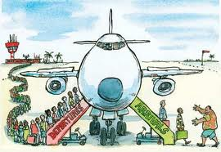
What is the negative impact of migration on the donor region?
Brain drain. Highly educated people with many skills are likely to migrate if they cannot find work in their country. This prevents full economic development in the donor region.
Example: African nations experience sever brain drain, as well as eastern European countries such as Estonia.
in 2011 the net migration rate for Estonia was 3.29 people per thousand.

Slide 5
What is the Positive impact of migration on host regions?
The two main positive impacts of migration for host regions.
Growth of an economy may depend on migrant workers. in countries such as France where the natural increase in population means is not enough people to fill jobs .
Example: in the 2000’s economic growth and the resulting demands for skilled and unskilled labour led to the in-migration of workers to Ireland. In 2005 alone Ireland needed 45000 immigrants to fill its workforce.
Migrants contribute to host regions. Because of migrants demand for goods and services. also their tax contribution to government funds. Interrogation of migrations creates a cultural and racial awareness in the host country. Leading to greater understanding and tolerance between different cultures.
Example: In 2008 13.81% of the Irish population was immigrants.

Slide 6
What is the negative impact of migration on the host region?
Pressure. Migrations usually need to find jobs and housing. The health, education, and transport services may be put under pressure. As well as high unemployment rates.
Integration of migrant workers. Although integration of migrant workers is also a positive impact in host regions, in community’s it may cause problems such as racism and discrimination. In the work
Environment exploitation of migrant works is particularly evident.
Why they gotta pressurise all my Regions and what not??

Slide 7
FACTs of migration!
More than 215 million people (3% of the world's population) live outside their countries of birth.
People migrate because of the PUSH and PULL factors. example push factors: war, famine, forced migration etc.
example pull factors: job opportunities, family planning etc.
A person forced to leave their country can be a refugee, when the person in question reaches the host region they then have two options, work illegally or apply for asylum, once they have applied for asylum they then become asylum seekers, if granted asylum then are then given refugee stases and can no longer face deportation.

Slide 8
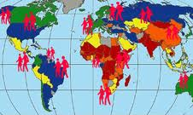
Picture time!

