Slide 1
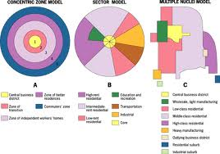
Examine briefly one theoretical model which attempts to explain the development of land use zones in a developed world
By Shannon Heffernan.
Question taken from: The Human Environment Elective Unit 5.
Planet and People, Second Edition, Leaving Certificate Geography

Slide 2
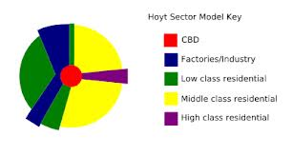
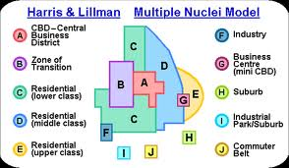
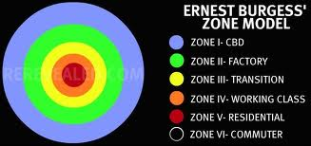
The three key theories.
Burgess :concentric zone.(1925)
This theory is based on the idea that land values are highest in the centre of a town or city.
Burgess stated that the outer edge of the CBD is constantly growing , he called this area the zone of transition.
Hoyt: Sector model. (1939).
this theory is based on burgess model, however Hoyt considers the impact of transport routes and land development.
Hoyts model shows that towns have grown sectors growing outwards from CBD, along transport routes.
Harris and Ullman: multiple-Nuclei theory.(1945)
This theory is based on the two previous theories.(mixture of the two)
Each nuclei has a growth pattern that occurs outwards. Until they all merge into one large urban area.

Slide 3
HARRIS AND ULLMAN.

Slide 4
Background.
Chauncy Harris and Edward Ullman are the geographers that developed this theory.
they suggested that an urban area develops over time.
An urban area grows around different business centres.(Multiple nuclei)
Harris and ullman developed their theory by suggesting a mix of the Concentric zone model (burgess) and the Sector model(hoyt).
The location of each land use reflects its economic needs.

Slide 5
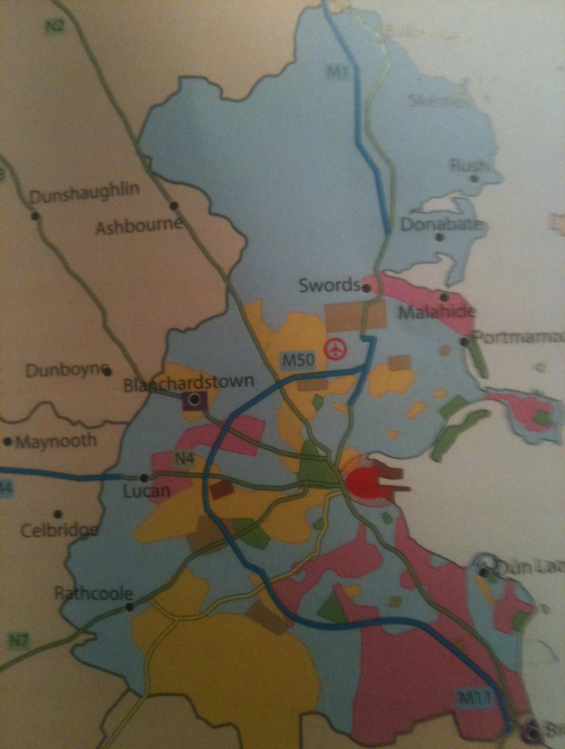
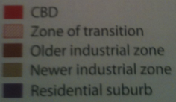
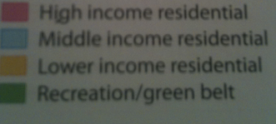
Where can we see this theory in use!
Many large urban areas and conurbations can be seen to have a similar layout as this model. E.g. Dublin Ireland.

Slide 6
How this model explains how chosen city develops.
Over time there has been much change in the land use of Dublin.
Dublin’s CBD has developed along the main commercial areas of Dublin.
Industrial land use in Dublin has two types of location:
The old industrial zone of Dublin port.
Newer industrial estates in the suburbs.
Dublin's zone of transition can be seen along the quays and docklands.
Residential land use in Dublin is linked to the wealth of the people living in the area.
Low-income
Middle-income
High-income.
However many of the residential sites of Dublin have changed over the past 100 years. i.e. Ringsend, once a low income area has become a more desirable location to live because of the walking distance to the city.

