Slide 1
River Drainage Patterns
5th year Geography

Slide 2
Learning Intention
Gain an understanding of the four main river drainage patterns.
Recognise and identify the patterns in diagrams, in photos and on OS Maps.

Slide 3
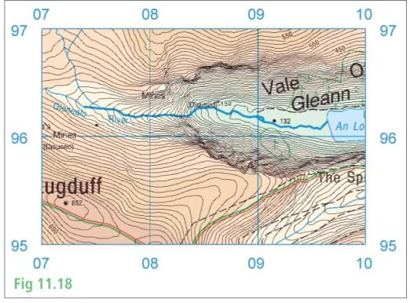
River Drainage Patterns
Dendritic
Radial
Trellis
Deranged

Slide 4
Dendritic Pattern
Similar in appearance to a tree
Develops in areas that have rocks of equal hardness
Develop where the river follows the slope of the physical landscape
Tributaries join the main river at an acute angle; less than 90°

Slide 6
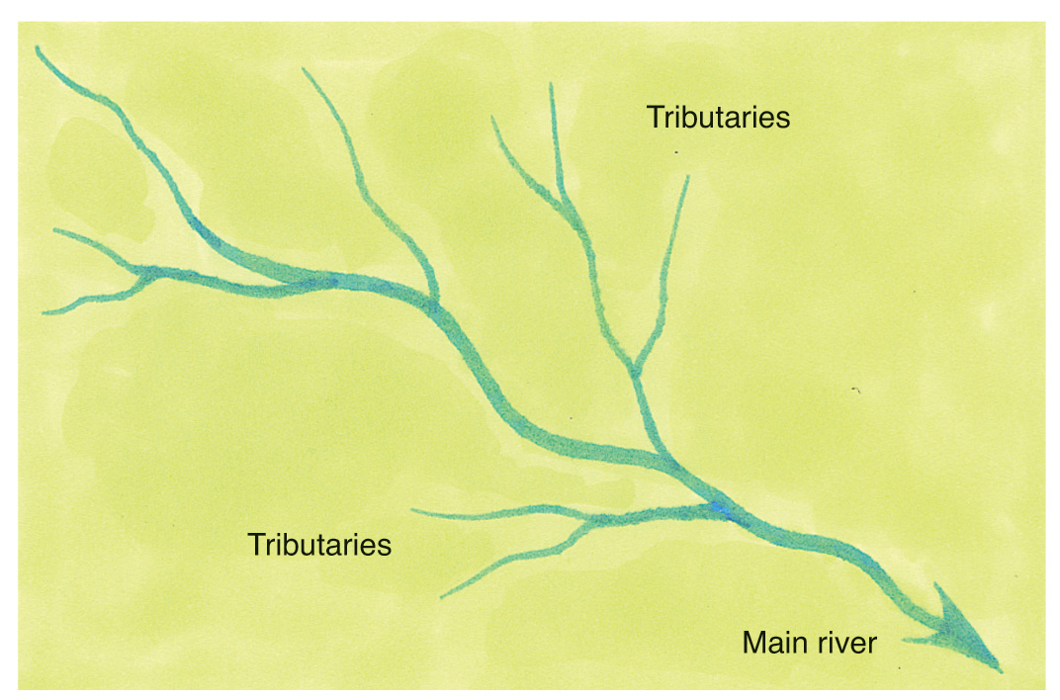
Dentritic Drainage
Notes:
Dendritic Drainage

Slide 7
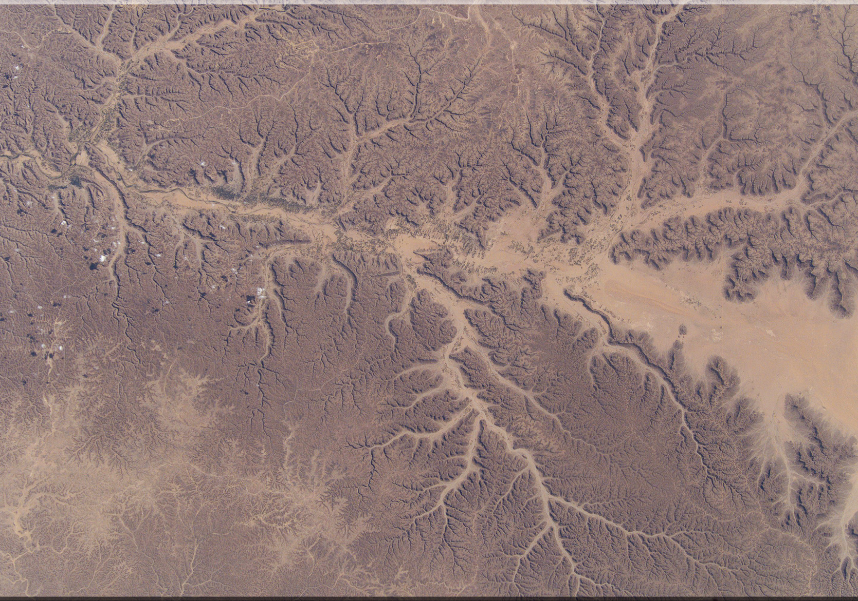
Notes:
Dendritic Drainage

Slide 8
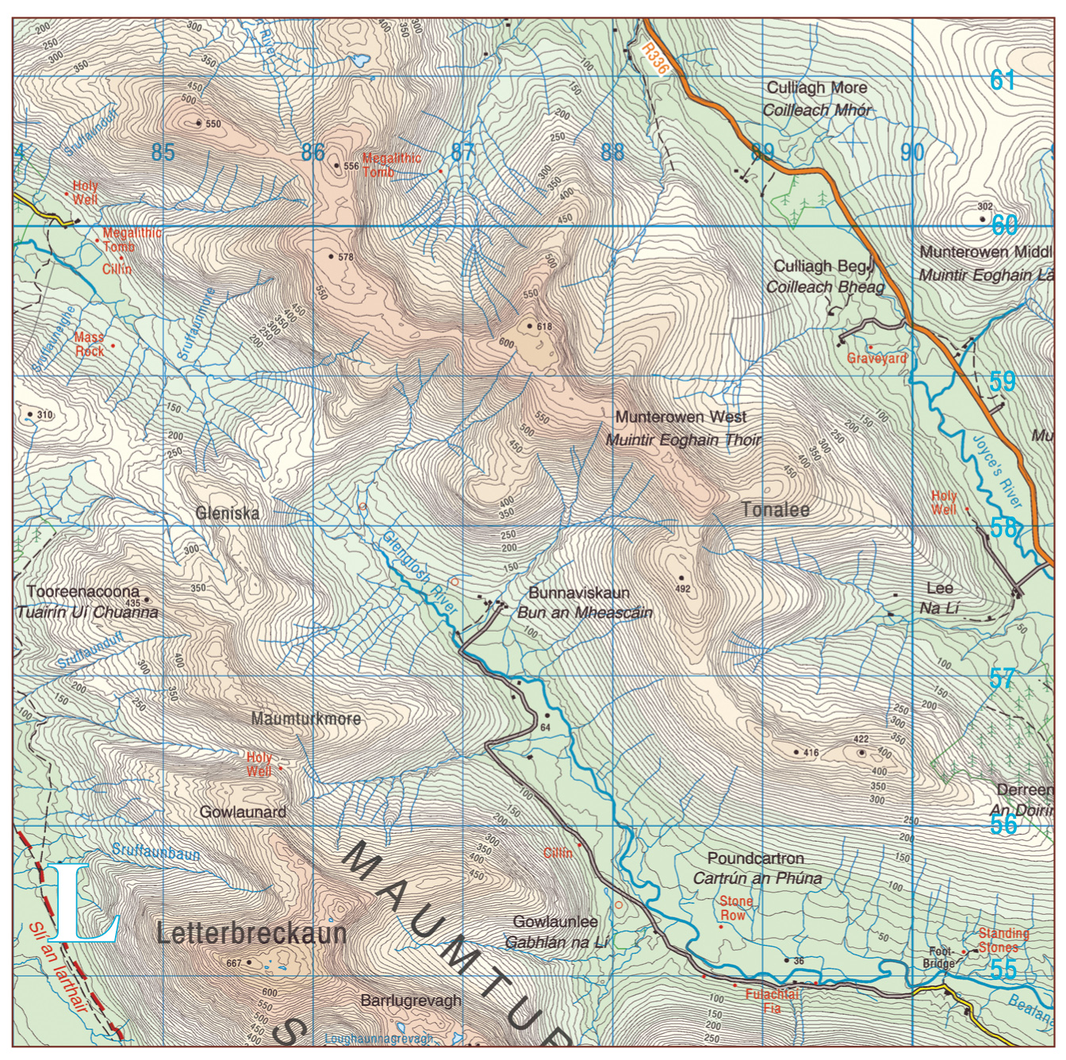
Notes:
Dentritic Drainage Patterns

Slide 9
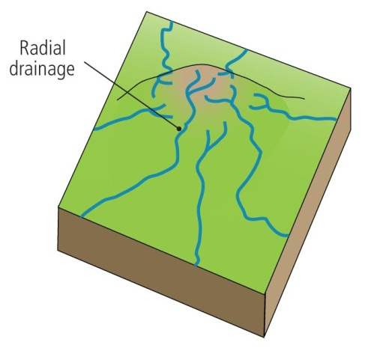
Radial Pattern
Similar in appearance to the spokes of a wheel
Rivers radiate down from a central apex on the top of a mountain

Slide 11
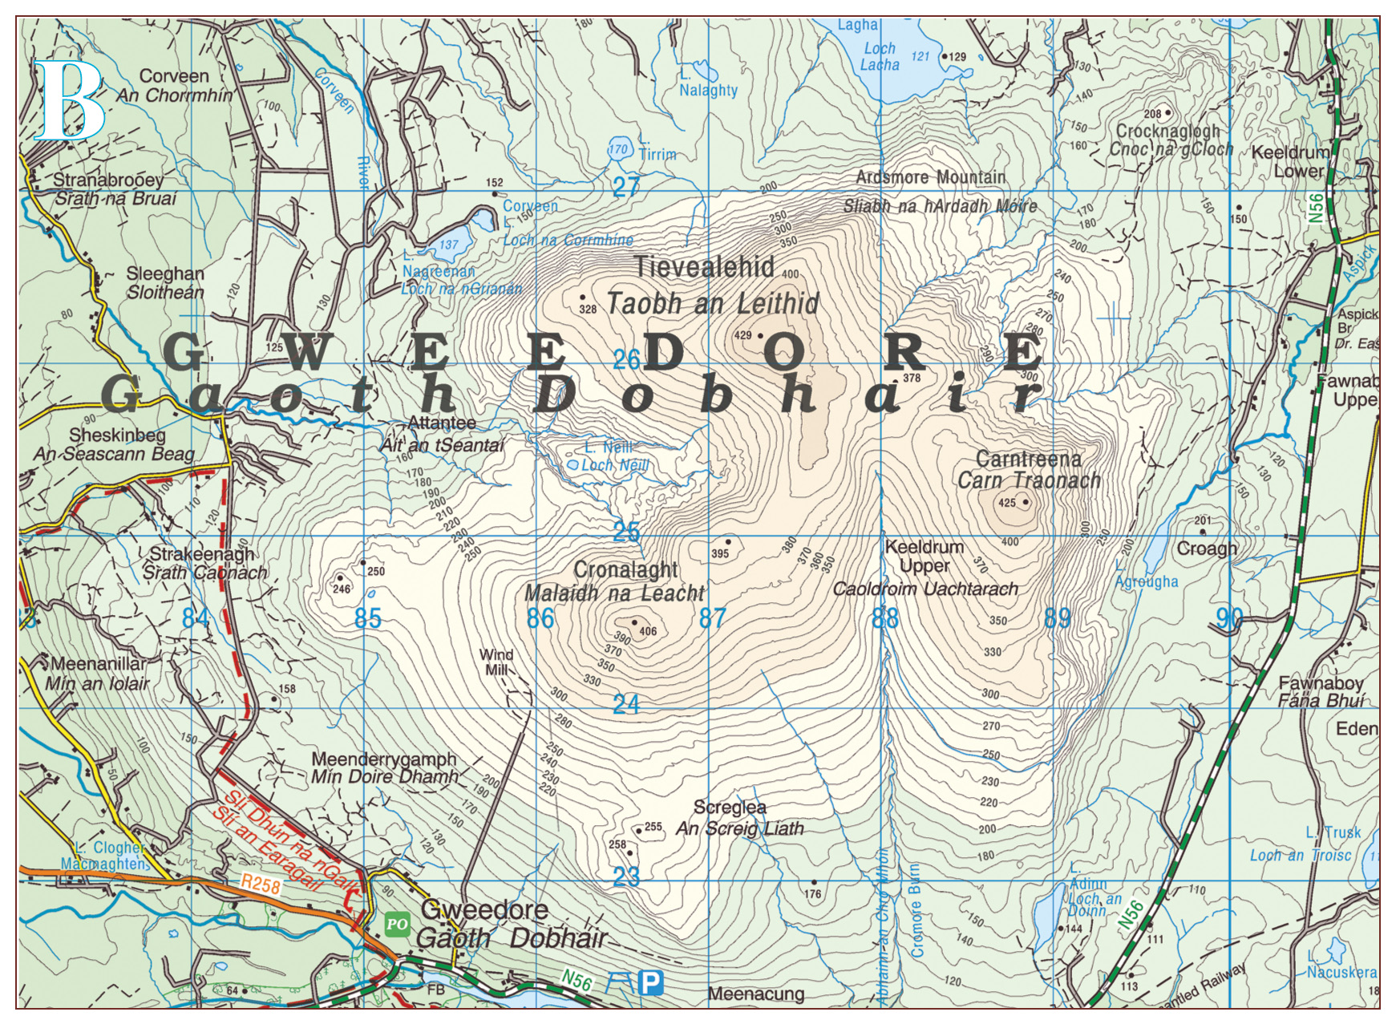

Slide 12
Trellis Pattern
Occurs where rivers have tributaries joining the main river at right angles in areas that have rocks of unequal hardness, i.e. areas of hard and soft rock
Differential erosion occurs where soft rock is eroded easily and faster than hard resistant rock
Forms in areas that have experienced folding, such as the Munster Ridge and Valley Province
The River Blackwater is a river found in this area and its tributaries join onto it at right angles

Slide 13
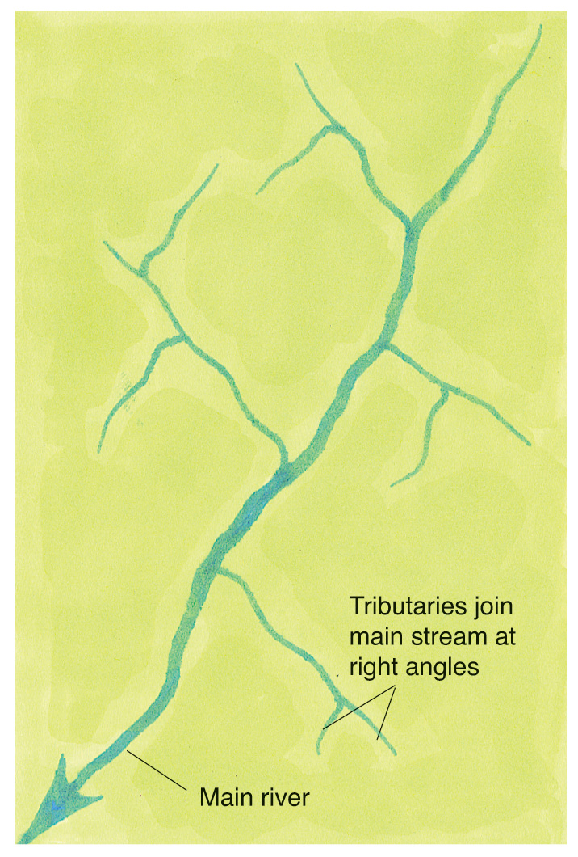
Notes:
Trellis Drainage

Slide 14
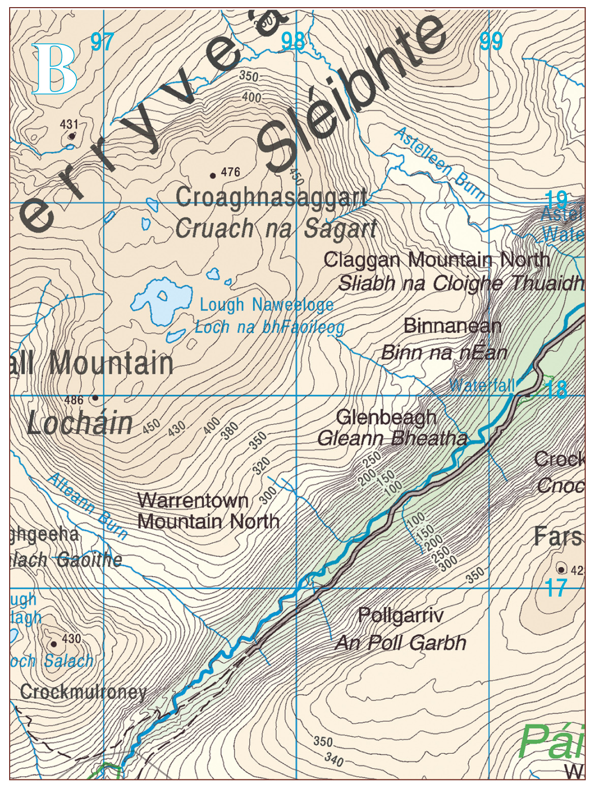
Notes:
Trellis Drainage

Slide 15
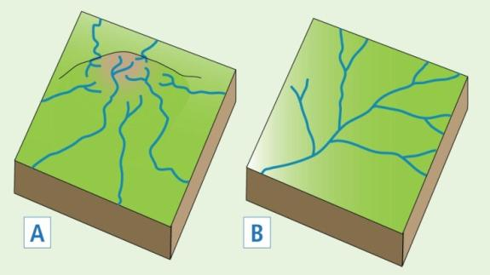
Deranged Pattern
Occurs where glaciation has impacted on the landscape
Rivers are irregular in their pattern/appearance

Slide 16
Exam Questions

