Slide 1
Rocks
Rock Cycle

Slide 2
Learning Outcome
Identify how each rock type can be changed into another
Understand the steps on the diagram
Draw the labelled diagram into your notes copy
In pairs, answer questions based on the rock cycle to fully clarify understanding

Slide 3
Rock Cycle
The process by which each rock type can be changed into another.

Slide 4
Rock Cycle Affects;
Igneous
Sedimentary
Metamorphic Rocks

Slide 5
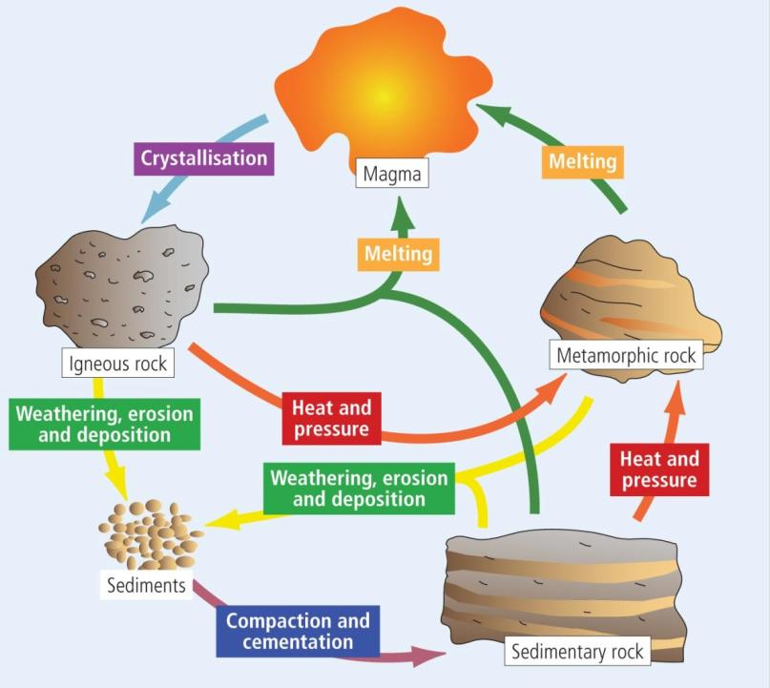

Slide 6
Rock Cycle
Rocks are continually;
Formed
Changed
Destroyed
Reconstituted

Slide 7
Keywords
Plutonic/ Intrusive - Rock formed within the crust of the earth. Eg; Basalt
Denudation- Weathering & Erosion, breaking rocks down into smaller pieces.
Strata- Rocks that have been laid down in layers. Eg; Limestone
Lithification- Sediment compacted under pressure, become solid rock.

Slide 8
Pair-work; Questions
What processes change sedimentary rock to metamorphic rock?
What processes change igneous rock to metamorphic rock?
How is sediment converted to sedimentary rock?
How is metamorphic rock converted to sedimentary rock?
How does magma change to igneous rock?
How is sedimentary rock changed back into sediment?
How is metamorphic rock converted into magma?

Slide 9
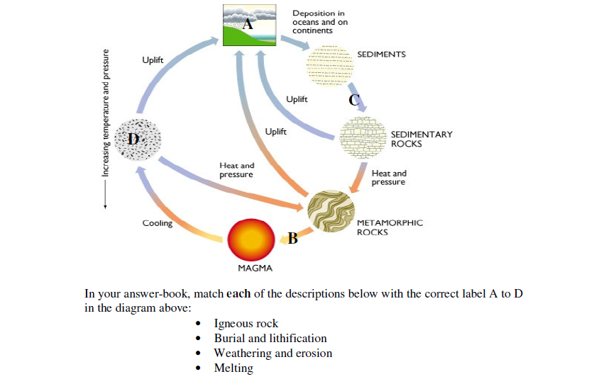
Exam Paper Question

Slide 10
Homework
Revise pages 50 & 51
Page 60 Question 4, in homework copy

