Slide 1
The impact of human activities on Biomes
Geoecology Option

Slide 2
Human activities have changed biomes by:
Settlement
Deforestation
Intensive agriculture
Industrial activity
These are the four aspects we will discuss in the sample answer.

Slide 3
Settlement
In
Ireland
And
Brazil

Slide 4
Settlement
Approx.9000 years ago Ireland was covered in a deciduous mixed woodland. The most common trees were oaks, elms, pines and ash.
Approx 6000 years ago the first farmers began to clear woodlands to make new farmlands.
Into the bronze and iron ages and the tools used to clear land improved so the removal of forested areas increased.
From 600BC to 500AD the greatest amount of forest disappeared.
Some trees were protected by laws such as oaks, hazels, yews and holly's. These were referred to as ‘Nobles of Wood’.
Under old Brehon Laws anyone caught damaging one of the ‘nobles’ had to pay a fine of two milk cows and one three-year old heifer.

Slide 5
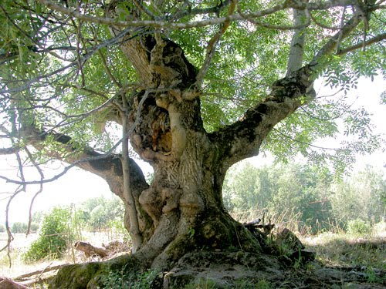

Slide 6
In 1100 AD the Vikings arrived and built coastal settlements requiring large amounts of wood. This saw further deforestation especially along the east and south coast of Ireland.
Up to the 1900s wood was the greatest source of energy and heat in Ireland. By the start of the 20th century only .5% of Ireland was covered in forest.
Government and European laws now dictate that each country must try to raise the percentage of forested areas to the EU average of 31%.
Ireland is currently around 14%.

Slide 7
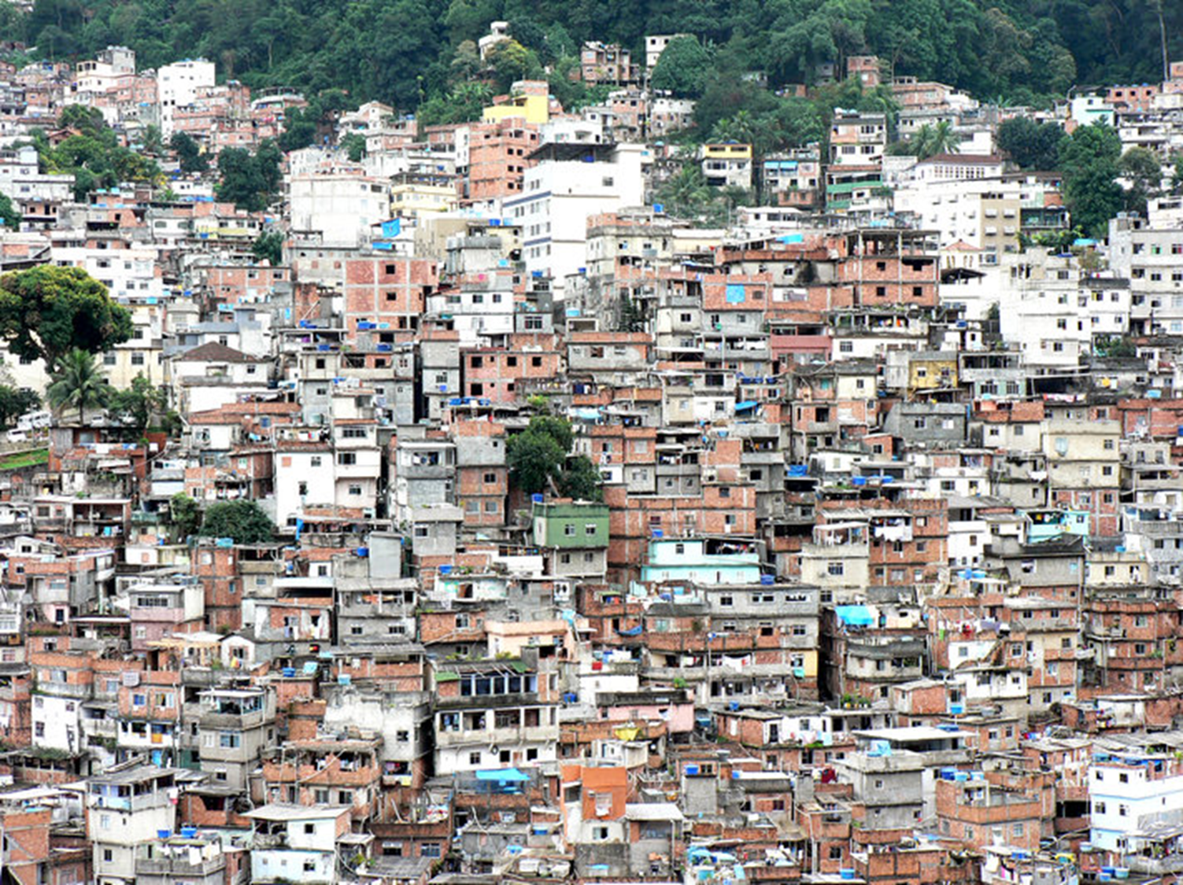

Slide 8
In Brazil overpopulation is placing huge demands on the tropical rainforest.
A new capital city, Brasilia, was built from scratch during the 1950’s and 1960’s in the heart of the Amazon rainforest.
This was to encourage settlement of the region.
Today it has a population of 2.3 million.
To construct this city, large areas of forests were cleared.
More deforestation occurred on the outskirts of the city where small, temporary housing settlements were built for migrant workers who moved to this area in order to construct the new capital city.
Instead of returning to their original homes upon completion of the city, these workers chose to stay and avail of the greater opportunities in Brasilia.

Slide 9
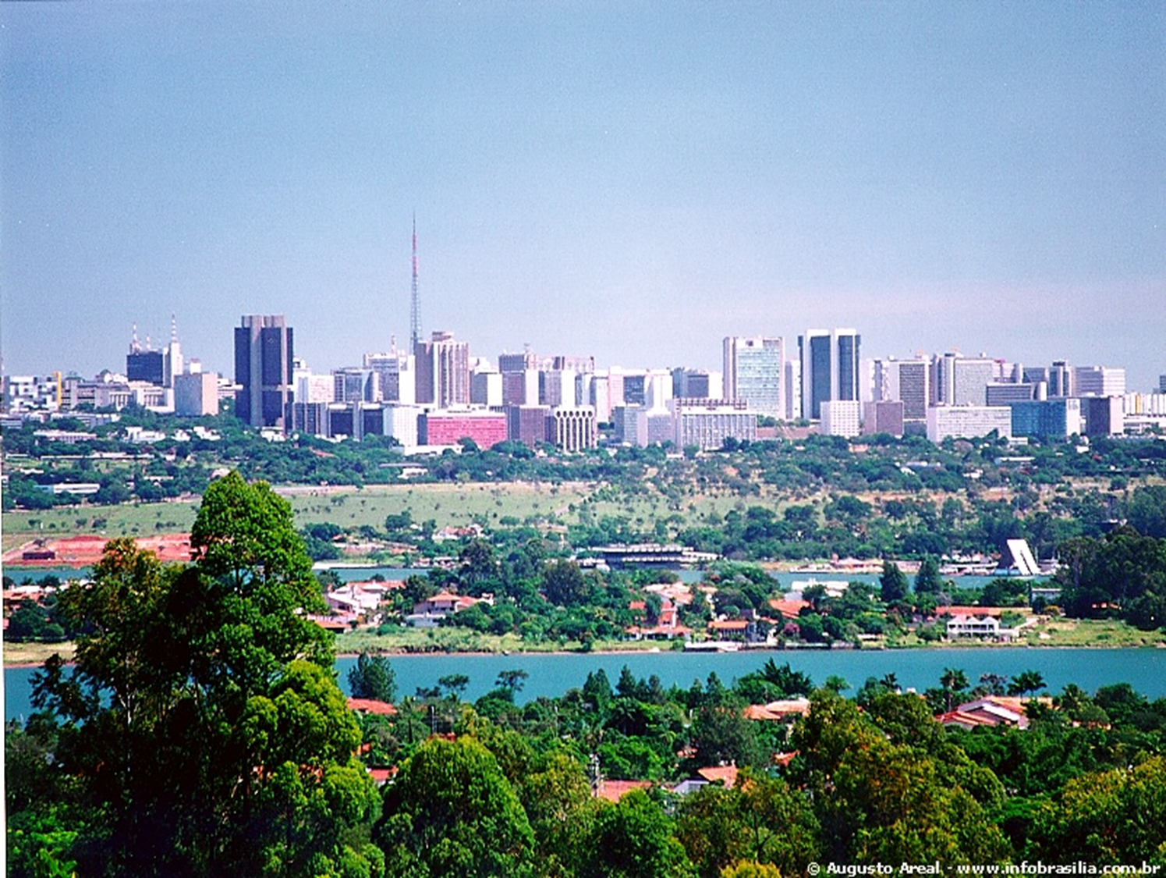

Slide 10
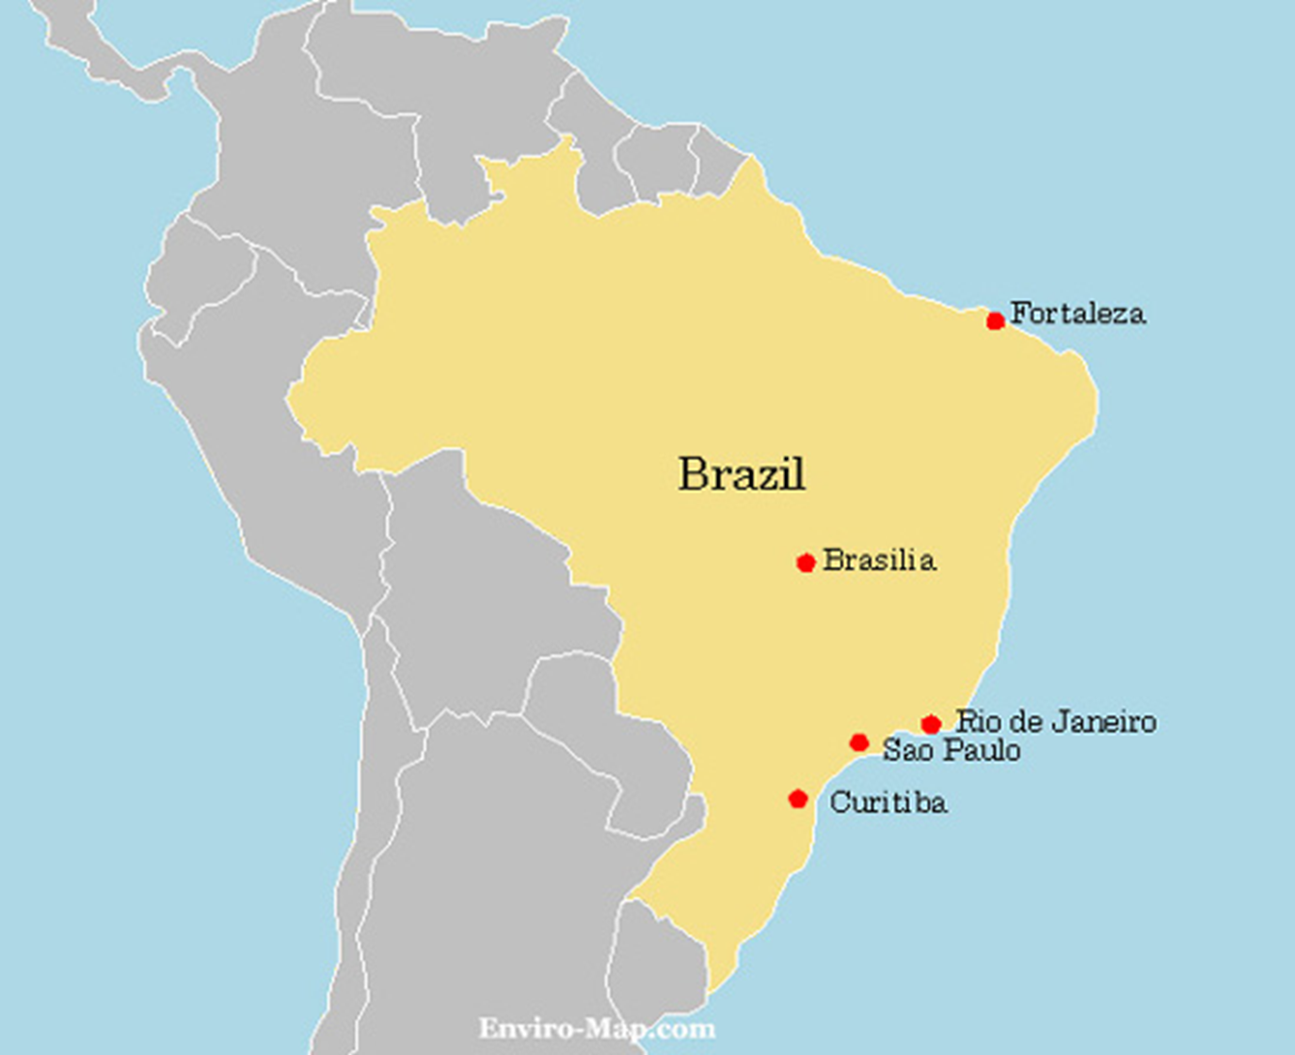

Slide 11
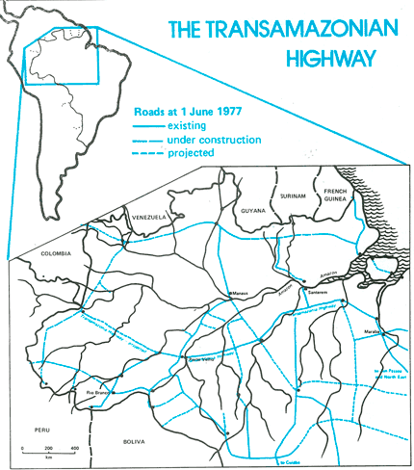
As cities continued to develop and sprawl in Brazil, the transport network connecting these cities needed improvement.
This resulted in further clearing of forests to make way for the new roads.

Slide 12
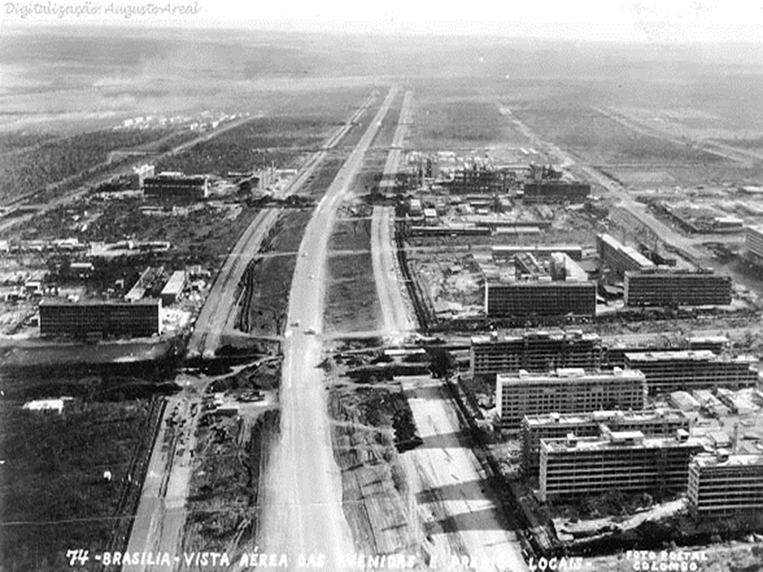

Slide 13
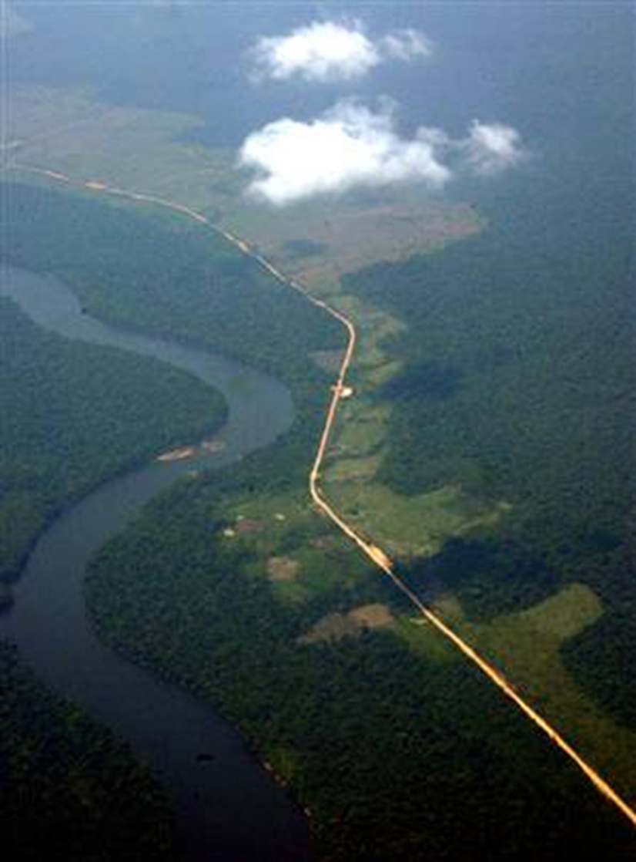
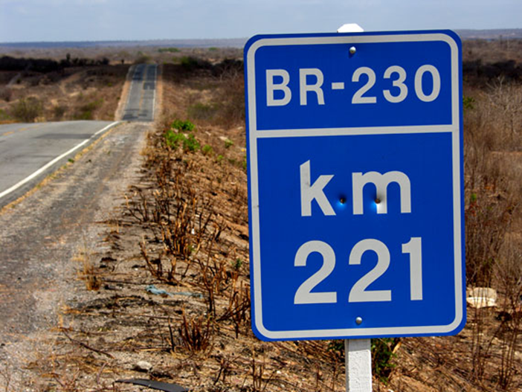

Slide 14
Deforestation

Slide 15
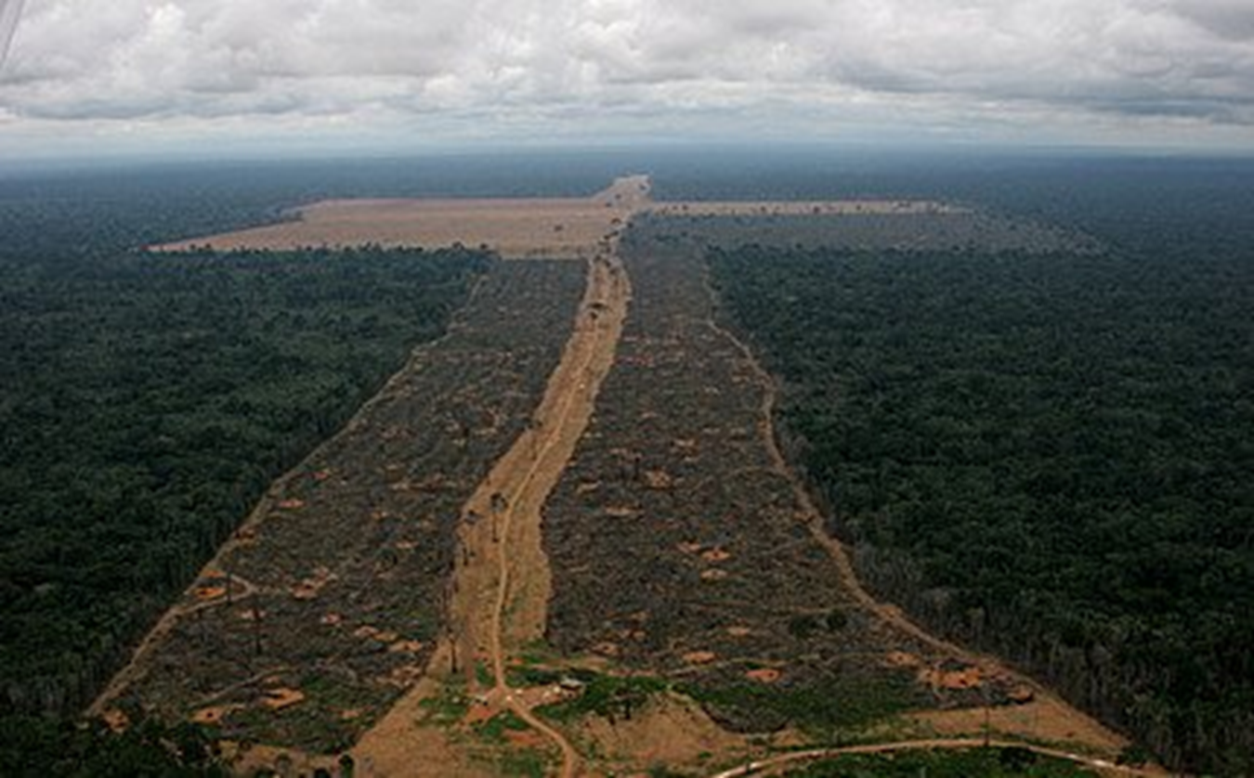
The deforestation of the tropical rainforests is an example of how humans can alter the natural characteristics of a biome.

Slide 16
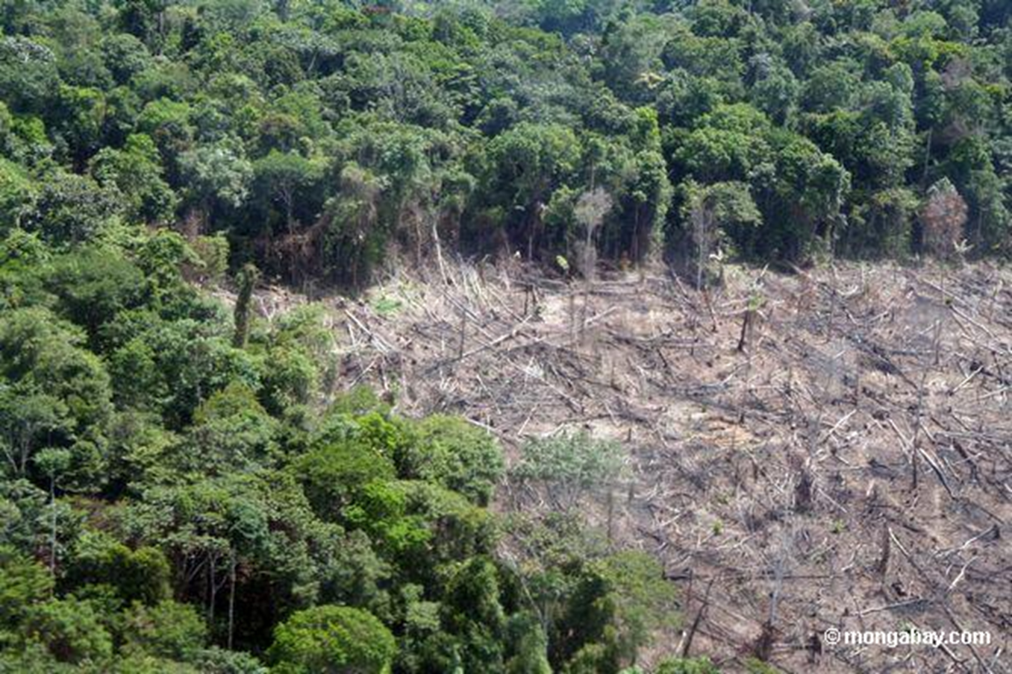

Slide 17
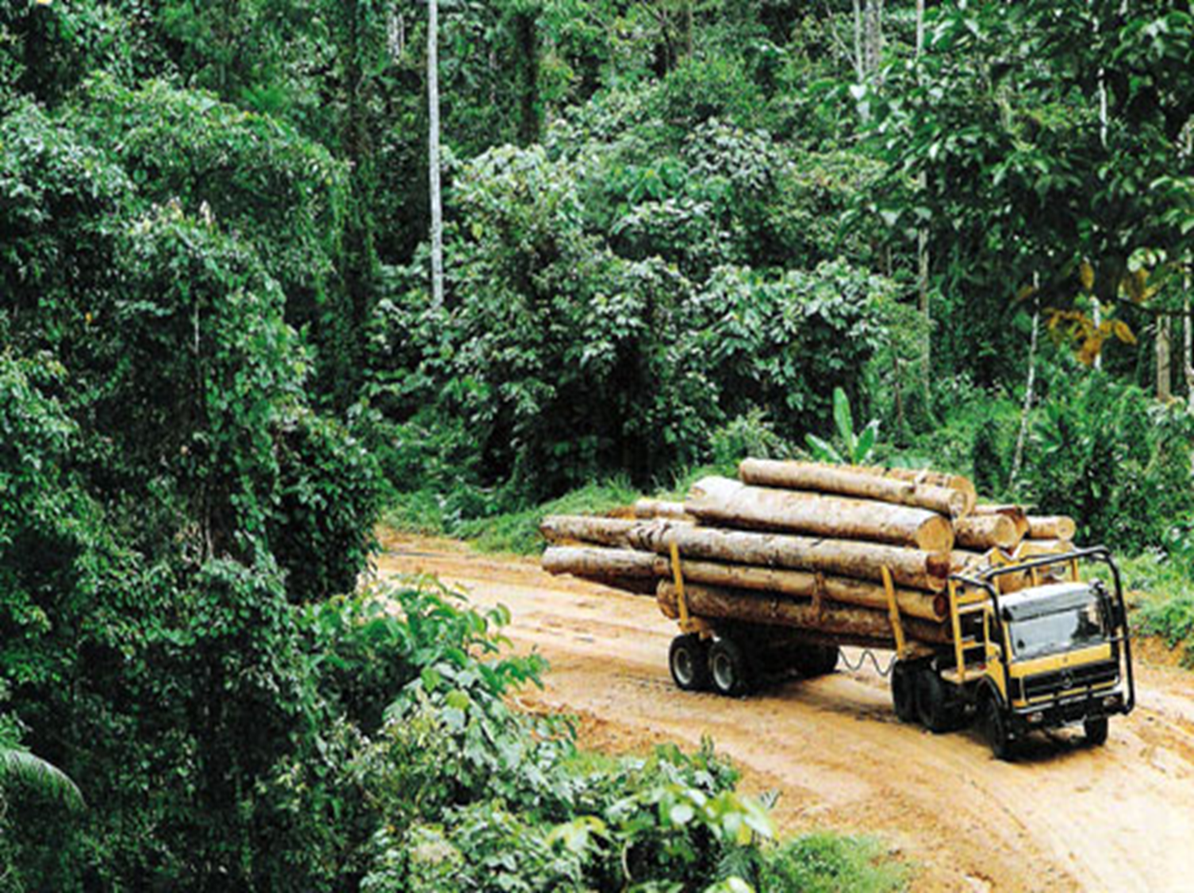

Slide 18
Tree felling causes a loss of nutrients in soil.
Less vegetation and leaves means less organic matter for humification.
Less humification means less humus.
Exposed areas of soil increases soil erosion.
No leaves = no interception.
Less trees and roots on sloping areas means less soil stability.
Heavy rainfall causes increased surface run-off.

Slide 19
Why are the Brazilians cutting down the tropical rainforest
at an alarming rate??

Slide 20
AVANCA BRASIL
Government Policy to use the resources of the Rainforest to develop Brazil's economy

Slide 21
In January 2000, the Brazilian government announced its plans for Avanca Brasil (Advance Brazil).
This was a €30 billion plan to cover much of the Amazon rainforest with 10,000km of highways, hydroelectric dams, power lines, mines, gas and oilfields, canals, ports, logging concessions and other industrial developments.

Slide 22
Why????
1. Overpopulation and poverty in Brazilian cities creates political difficulties.
2. The government wants to open up the Brazilian rainforest to take advantage of its timber and mineral wealth.
3. Beef producers require more land to herd massive numbers of cattle for the beef trade.
4. Brazilian industry requires more power if it is to develop and maintain its industrial strength.

Slide 23
Illegal growing and felling of timber is also leading to rapid deforestation, fuelled by demand for cheap supplies of plywood and tropical timber locally and abroad.
Illegal timber is estimated to account for 80% of all timber produced in the Brazilian Amazon.
As the area is rich in resources, licenses were given to mining companies to clear forests and mine for metals such as iron ore and copper.

Slide 24
Intensive Agriculture

